Slide 1
UW PHARMD INFORMATION SESSION

Slide 2
UW SCHOOL OF PHARMACY MISSION
INSPIRING EDUCATION: Develop exceptional, innovative and diverse pharmacy leaders and scientists.
DISCOVERING SOLUTIONS: Advance the science, development, implementation, and outcomes of safe and appropriate treatments.
SERVING PEOPLE AND COMMUNITIES: Promote the health and well-being of the public, locally and globally.

Slide 3
THE HUSKY PHARMACIST
Demonstrates Expertise
Thinks Critically
Possess Strong Decision-Making Skills
Works Collaboratively
Demonstrates Leadership
Adapts and Thrives
Communicates Well

Slide 4
UW PHARMD PROGRAM OVERVIEW
4-year professional degree program
PY1 – PY3 years on campus at UW
PY4 year on Advanced Pharmacy Practice Experience (APPEs)
Office of Experiential Education
Local, National and International APPEs
We emphasize: critical thinking, problem-solving and clinical skills prepares grads to:
Provide rational drug therapy
Reduce medication-related problems
Promote healthy lifestyles and disease prevention
Enhance patient adherence
Provide care in the changing health system

Slide 5
CURRICULUM - ELECTIVE OPTIONS
Broaden your career choices through a wide variety of elective courses
Position yourself for specialty practice areas such as geriatric pharmacy, health care in underserved communities, diabetes prevention and care, and more
Complete a certificate:
Plein Certificate in Geriatrics
Biomedical Regulatory Affairs Certificate
Clinical Trials Certificate
Extend your studies:
Pharmaceutical Outcomes Research and Policy (MS or PhD)
Biomedical Regulatory Affairs (MS)
PharmD/PA Program (5-year program)
PharmD/MBA Program (5-year program)

Slide 6
CURRICULUM - INTERPROFESSIONAL EDUCATION
Prepare for an evolving profession and environment
Located in the middle of UW health sciences
Take classes with students studying to be physicians, physician assistants, nurses, nurse practitioners, physical therapists, dentists, social workers, public health specialists, and other provider roles
Collaborate with health science colleagues in activities

Slide 7
CURRICULUM - PROFESSIONAL DEVELOPMENT OPPORTUNITIES
Extracurricular activities compliment your training Health fairs and screenings
Professional Networking Day
Community immunization programs
Tobacco cessation education
Under-served and rural community outreach in Washington State
International travel to provide health information and care to people in developing countries (i.e., Ghana, Panama, Nicaragua, Honduras, and India)

Slide 8
PHARMD PROGRAM OUTCOMES
2019 Graduate’s Plans
49% Community Pharmacy
46% Institutional Pharmacy
5% Fellowship
68% of our students that applied for residency matched into a program
Graduate Residencies Include:
Community: Bartell Drugs, Providence Monroe, QFC Pharmacy
UW Medical Center/Haborview/Seattle Cancer Care:
Ambulatory Care, Critical Care, Geriatrics, Oncology, Pain/Palliative Care, Pharmacy Administration/Master of Health Administration

Slide 9
PHARMD PROGRAM OUTCOMES
The UW PharmD Curriculum prepares graduates for licensure exams needed to practice pharmacy
NAPLEX 100% Pass Rate from the Class of 2019

Slide 10
PRACTICING PHARMACY IN WASHINGTON
Prescriptive authority for pharmacists (collaborative drug therapy agreements)
Pharmacist-provided immunization services*
Emergency contraception*
Tobacco cessation*
Pharmacists have provider status as part of the health care team, increasing patient access to care and allows for payments of services.*
UW alumni created an HIV PrEP service in their pharmacy, winning innovation awards
*UW-led initiative

Slide 11
PHARMD APPLICATION & INTERVIEW PROCESS
Be eligible to study in the U.S.
Complete pre-requisites
BA or BS recommended, but not required
Complete PharmCAS by December 2 (or Early Decision application – early September)
Submit your transcripts and recommendations to PharmCAS
In-person interview on campus for qualified applicants

Slide 12
PHARMCAS APPLICATION
PharmCAS Application Includes:
Application (demographic information, coursework uploaded)
Official Transcripts – sent directly to PharmCAS
Two Letters of Recommendation required
Includes a PharmCAS required recommendation form and optional letter of recommendation.
We are able to accept recommendations from a source who can speak to your professional demeanor, accountability and maturity, such as a professor, teaching assistant, employer or volunteer supervisor.

Slide 13
PREREQUISITE COURSEWORK
Courses from schools are assessed by the Admissions Director on how they meet the requirements.
Course syllabi may be required for evaluation.
A database is available on our SOP website that lists prerequisites by school
https://sop.washington.edu/pharmd/admissions/school-prerequisite-courses/

Slide 14
PREREQUISITE COURSEWORK
Anatomy & Physiology (4 sem. or 6 qtr. Credits – lab credit not included, must be lecture only)
Biochemistry (4 sem. or 6 qtr. Credits – lab credit not included, must be lecture only)
General Biology w/labs (8 sem. or 15 qtr. Credits)
Microbiology w/lab (4 sem. or 6 qtr Credits)
Inorganic Chemistry w/labs (8 sem. or 16 qtr. Credits)
Organic Chemistry w/labs (8 sem. or 16 qtr. Credits)
Calculus (3 sem. or 5 qtr. Credits)
Statistics (3 sem. or 5 qtr. Credits)

Slide 15
PREREQUISITES
2 English composition courses or 2 writing courses/1 English composition or Bachelors degree or higher (6 sem. or 10 qtr. Credits)
Interpersonal Communications/Public Speaking (3 sem. or 5 qtr. Credits)
Microeconomics (3 sem. or 5 qtr. Credits)
Humanities Electives (3 sem. or 5 qtr. Credits) - Examples are: Art & Art History, Speech Communications, Dance, Theatre, Music, Literature, Classics. Foreign languages may count towards humanities electives if they are 200 level and above. If foreign language courses are below 200 level, a full academic year is required or if student has an AA degree, we honor the previous school’s distribution.
Social Science Electives (3 sem. or 5 qtr. Credits) - Examples are: Anthropology, History, macroeconomics (not microeconomics), Psychology, most Women studies, Philosophy, Law, Sociology.

Slide 16
INTERVIEW PROCESS
Opportunity to assess fit on both sides
Evaluated in a variety of areas, including: motivation, verbal and written communication skills, personal attributes, knowledge of the pharmacy profession and issues affecting health care
Highly considered qualities: Integrity, maturity, responsibility, humanitarianism, compassion, leadership and the ability to overcome personal or social adversity
Interaction with faculty, current students and staff

Slide 17
TUITION & FINANCIAL AID
2019 - 2020 tuition & fees
Washington residents $32,712
Non-residents $54,324
Additional health science ($200) and lab fees ($20-60/lab)
Submit your FAFSA to apply for financial aid
SOP scholarships typically range from $1,000 to $3,000
Merit and need-based alumni and donor scholarships are available/

Slide 18
QUESTIONS?

Slide 19
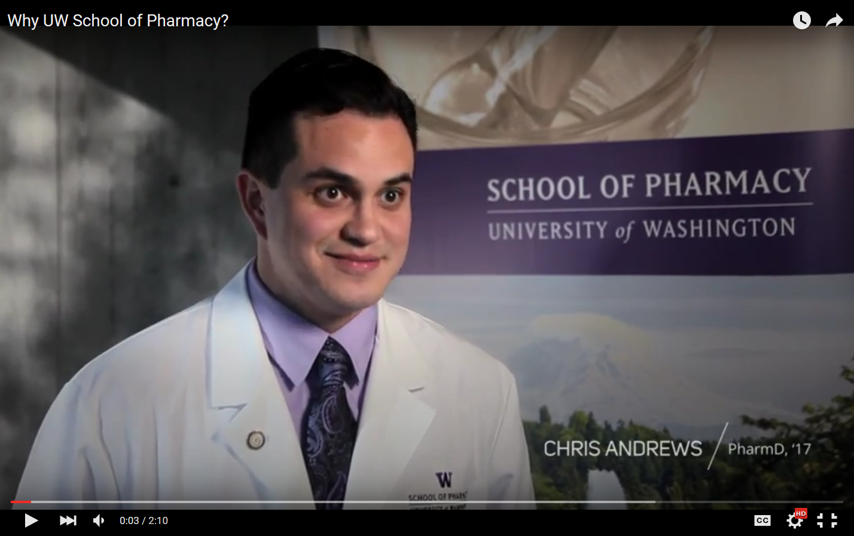
WHY UW? JUST ASK OUR STUDENTS…
https://www.youtube.com/watch?v=mJ7N3vMNKZE&feature=youtu.be

Slide 20
Keep In Touch!
Email: uwpharmd@uw.edu
Web: sop.uw.edu
Bailey Clem – bclem@uw.edu Associate Director of Recruitment

