Slide 1
Mobile Medicare Clinics 2018
University of the Pacific
Thomas J. Long School of Pharmacy and Health Sciences

Slide 2
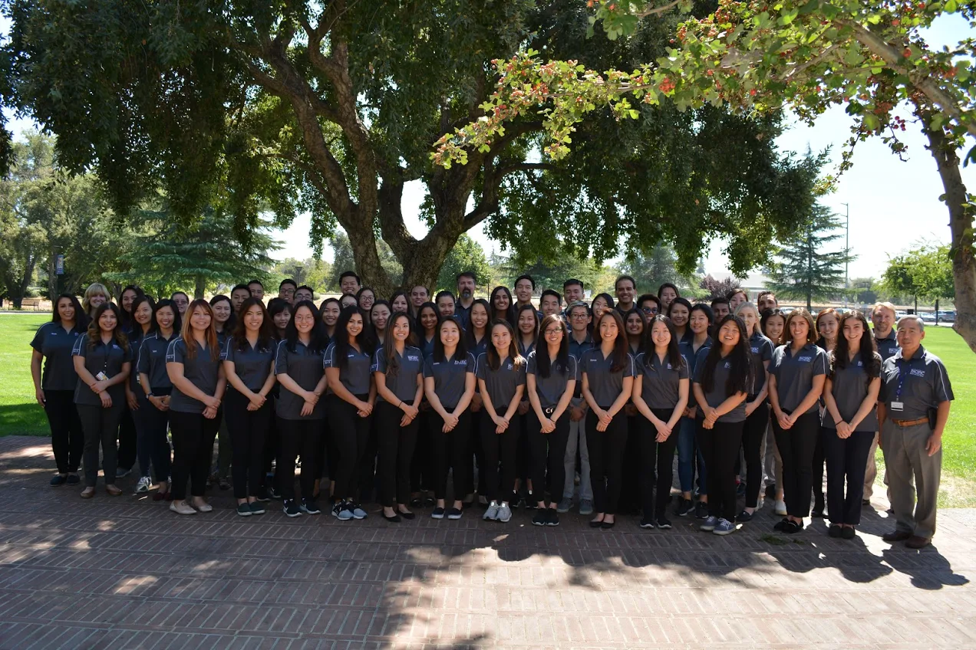
Who Are We?
Student Pharmacists at the Thomas J. Long School of Pharmacy and Health Sciences
Students enrolled in Medicare Part D Elective Course

Slide 3
What is Medicare?
A federal health insurance program that covers more nearly 60 million Americans:
Age 65+
Permanently Disabled
End-Stage Renal Disease
Amyotrophic Lateral Sclerosis (aka Lou Gehrig’s Disease)
Exposed to Environmental Health Hazards

Slide 4
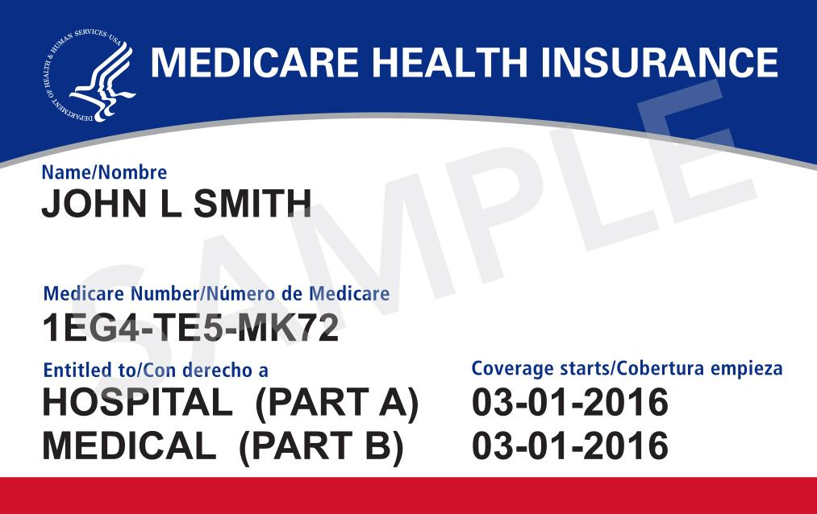
Parts of Medicare
Four different parts of Medicare:
Part A = Hospital
Part B = Medical
Part C = Part A + Part B +/- Part D
Part D = Outpatient Prescription Drugs

Slide 5
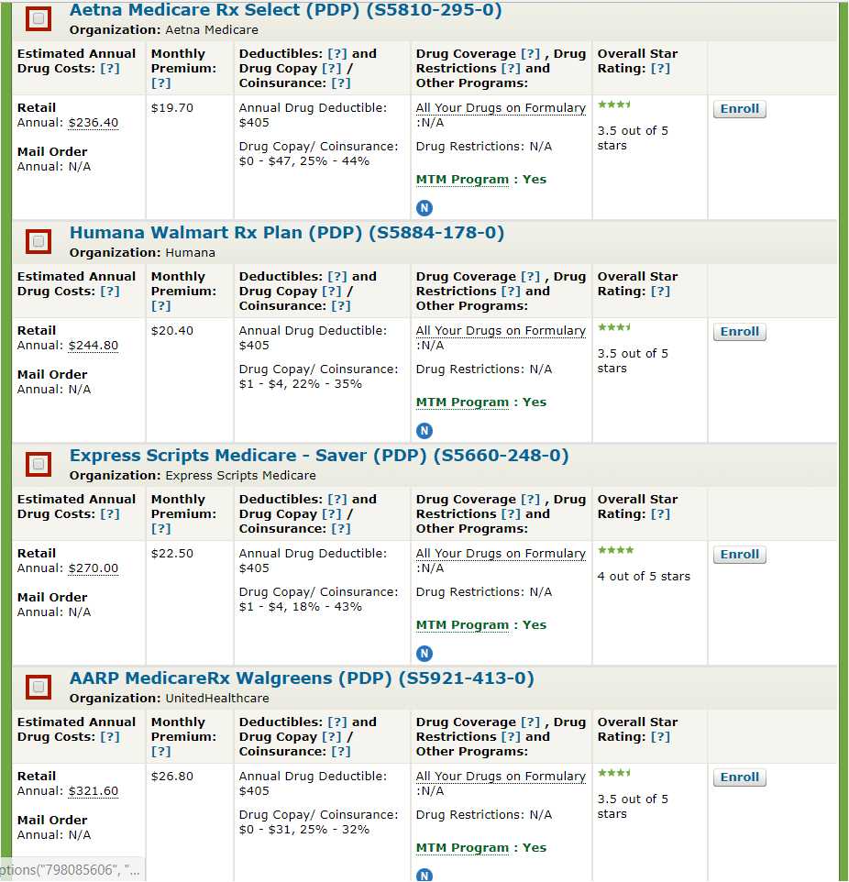
Medicare Part D
Many aspects of each Part D plan changes annually
Premium
Deductible
Formulary
Cost-sharing structure (e.g.,co-pays)
Drug utilization requirements

Slide 6
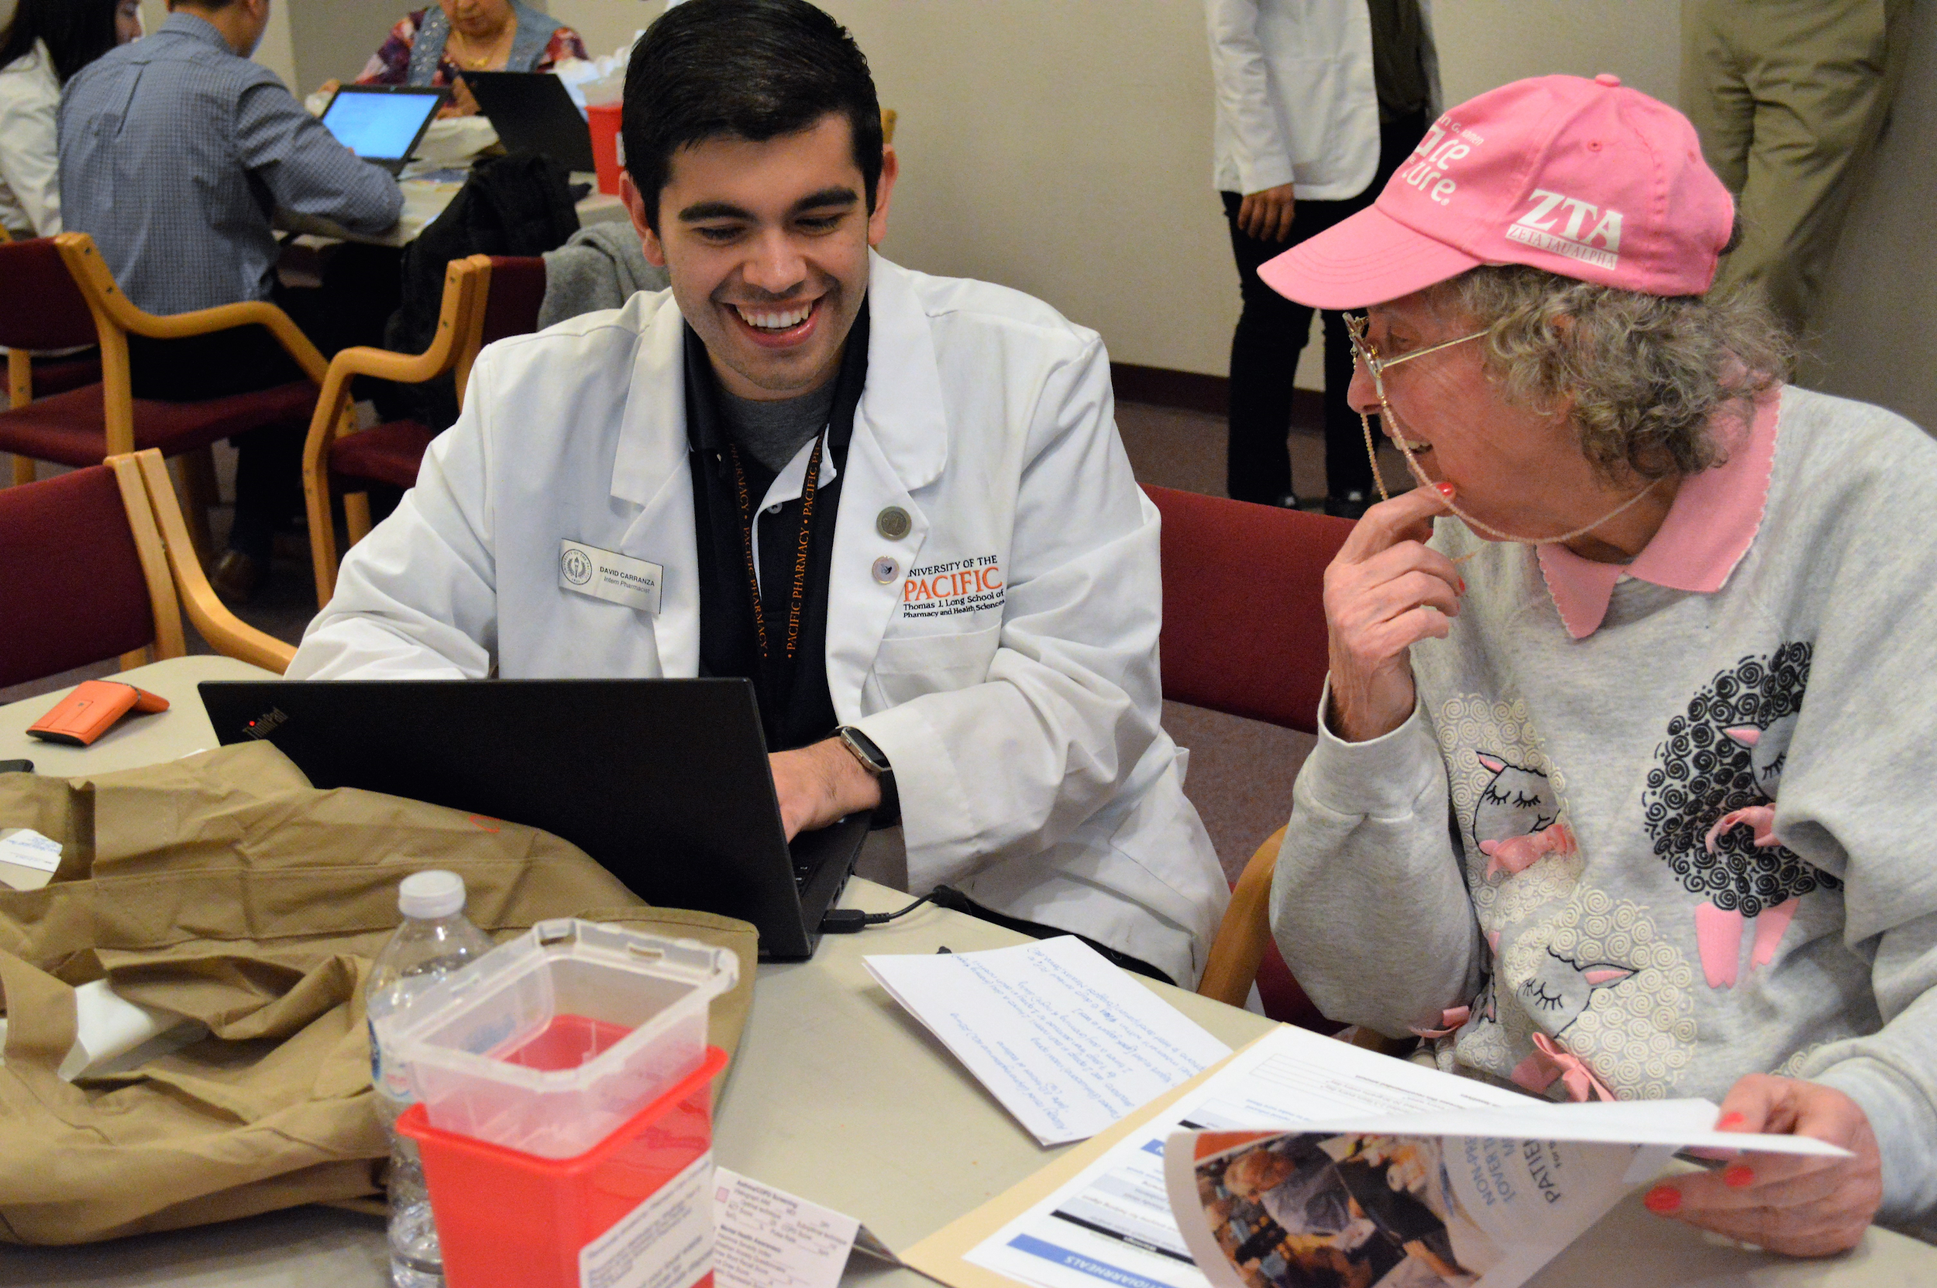
How we help…
Medicare Part D Plan Optimization
Potentially save them $ on their prescription costs
Medication Therapy Management (MTM)
Evaluate all of their medications
Safety and effectiveness
Increase engagement and understanding
Health screenings/services
Notes:
.

Slide 7
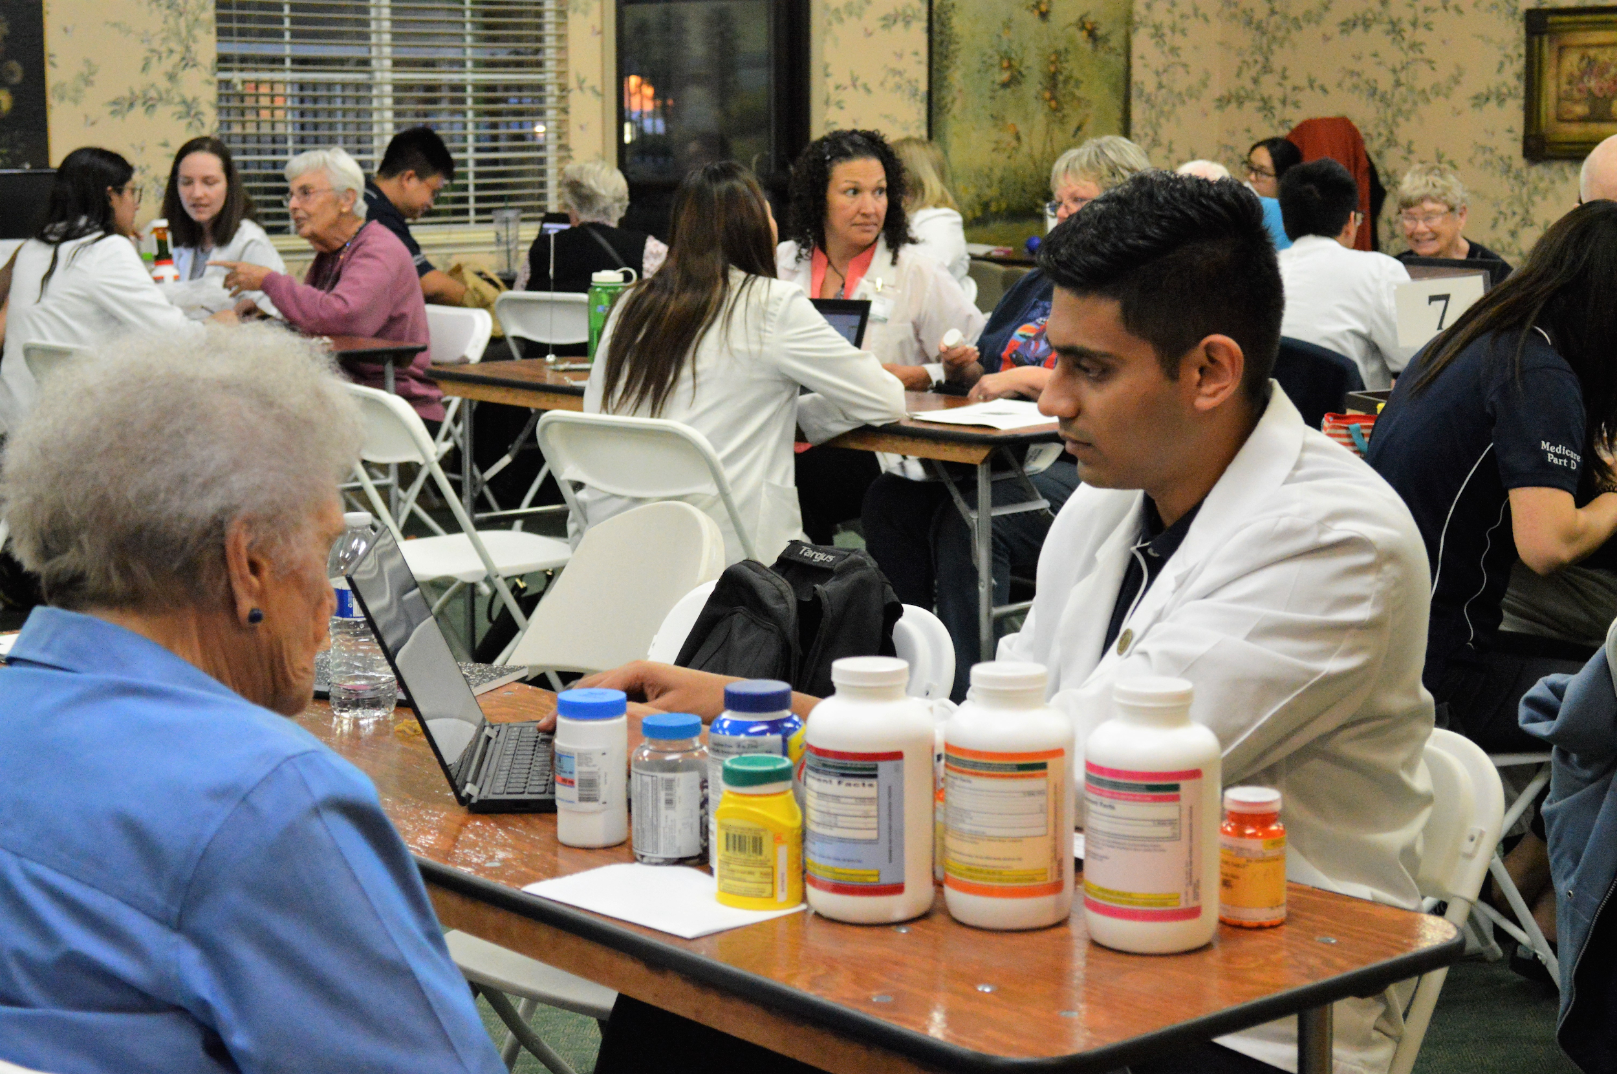
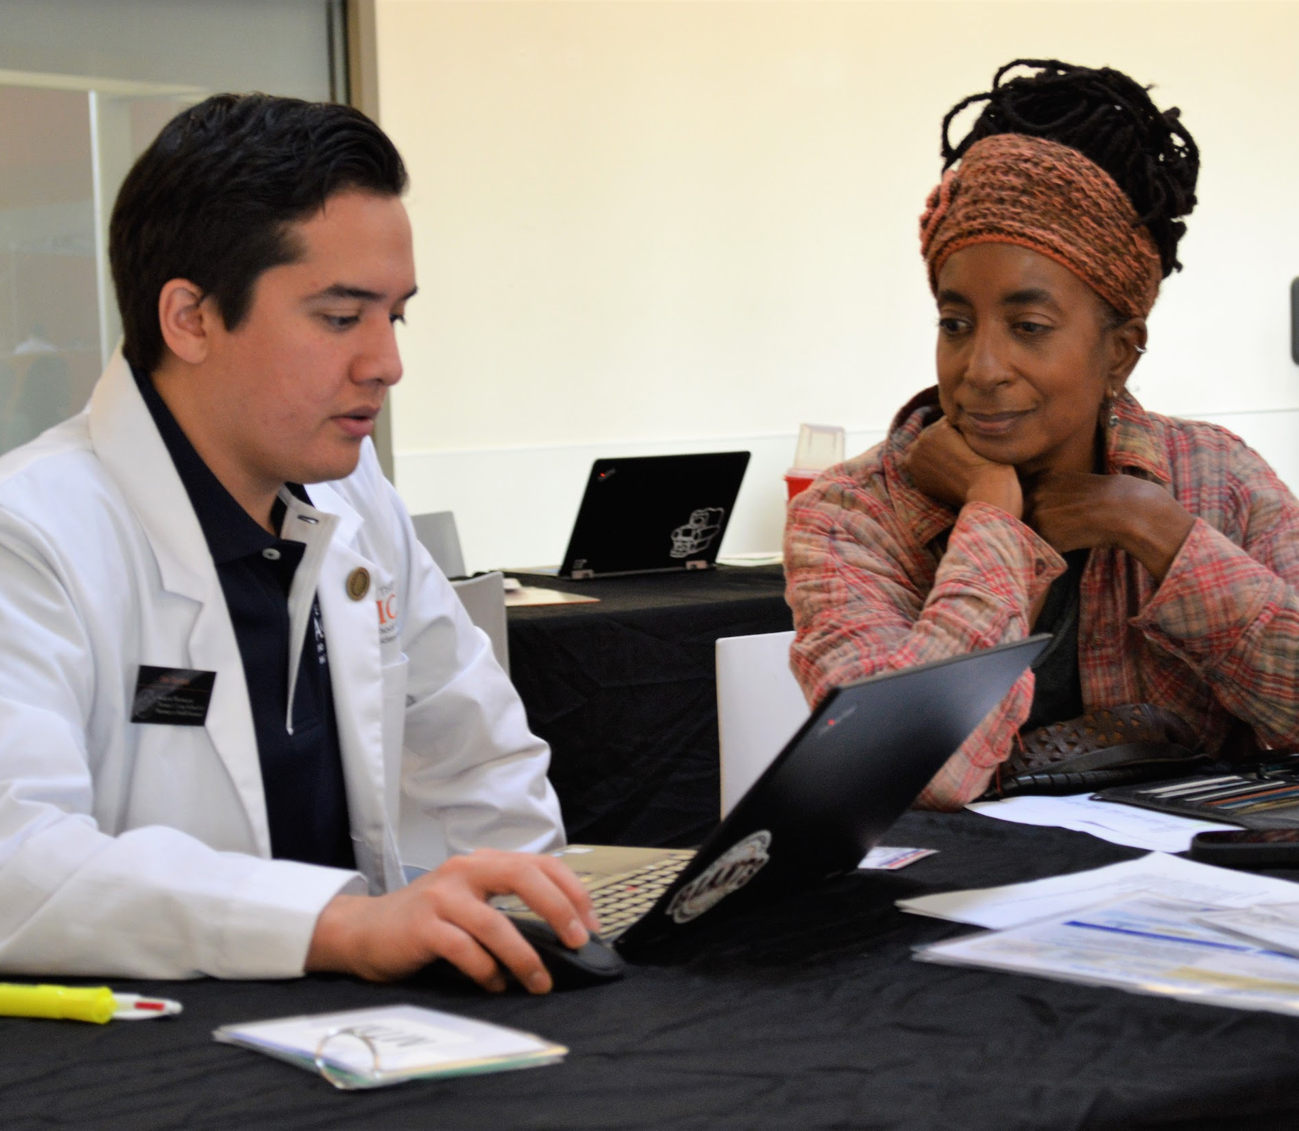
Medication Therapy Management (MTM) Services
MTM Review
Side effects
Adherence
Education
Efficacy
Duplicate therapy
Drug-Drug Interactions
Prescriber follow-up
Personalized Medication Record

Slide 8
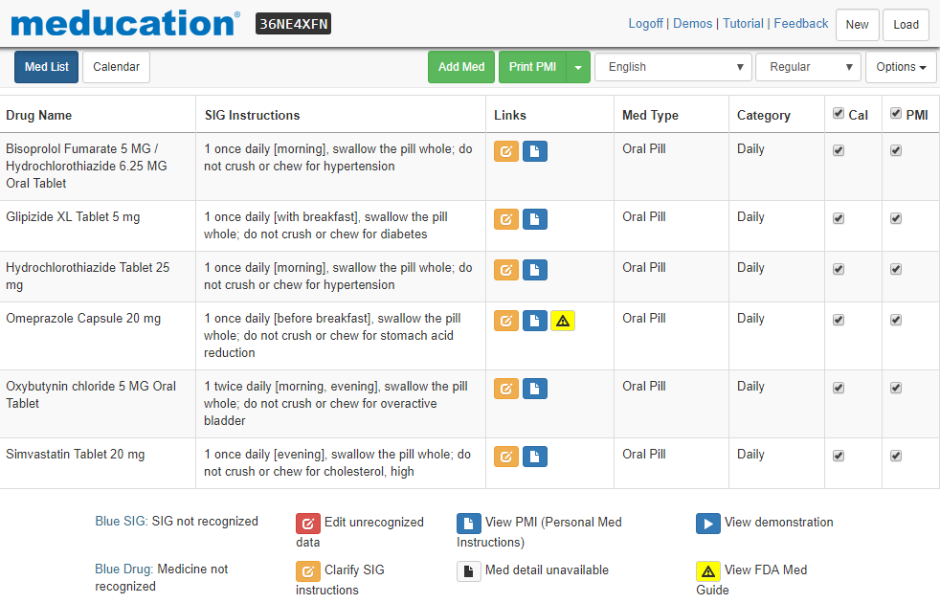

Slide 9
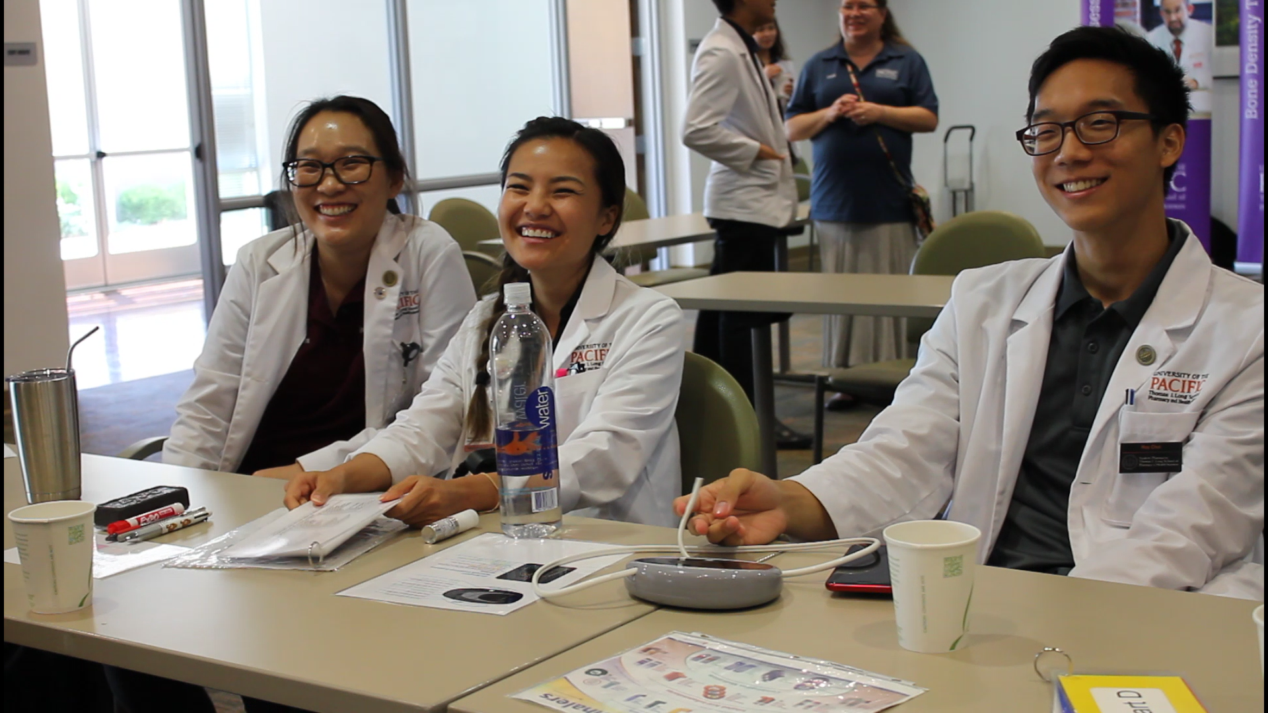
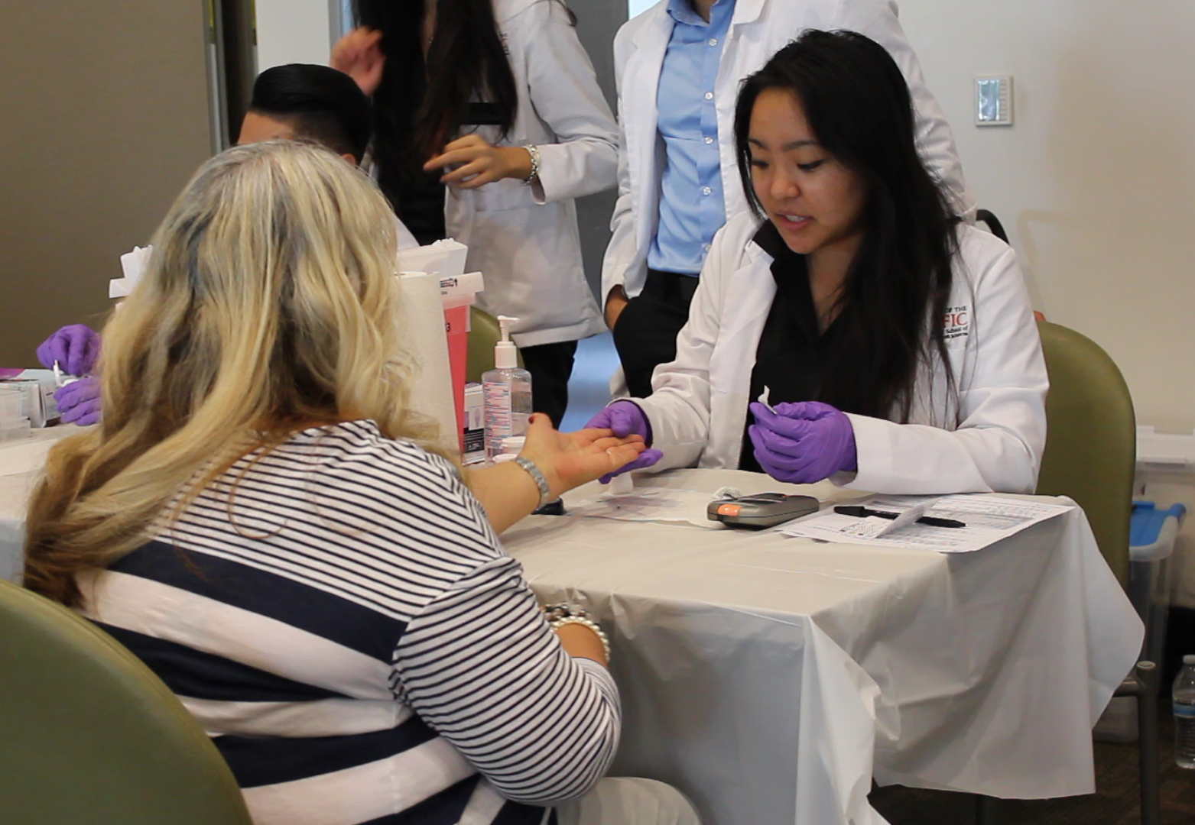
How we help? Health Services/Screenings
Immunizations
Asthma and COPD
Bone Density
Blood Pressure
Cholesterol
Diabetes
Memory
Depression
Falls Risk Assessment
Anemia
Anxiety
Sleep disorders
Medication/Sharps disposal
Narcan

Slide 10
Opioids: What are they?
Opioids are a class of drugs that include:
Heroin (Schedule I)
Fentanyl, oxycodone, hydrocodone, codeine, and morphine (prescription opioids)
Prescription opioids are mostly used to treat moderate-severe pain
Potential for abuse and misuse

Slide 11
So, what is the big deal?
The Opioid Crisis
In 2017 there was a total of 191 million opioid prescriptions dispensed in the U.S.
In 2017, Alameda County dispensed 759,873 opioid prescriptions
From this total there were:
144 hospitalizations
35 deaths due to opioid overdose

Slide 12
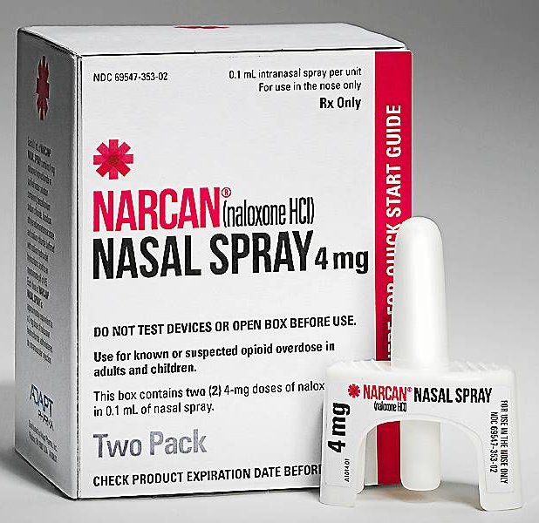
How will the Mobile Medicare Clinics Assist?
The Medicare class at UOP will be dispensing a drug called Naloxone (Narcan)
Naloxone can be administered via an intranasal spray or an intramuscular injection
Used to reverse opioid induced depression
We will be distributing the Narcan Nasal spray at our Medicare events

Slide 13
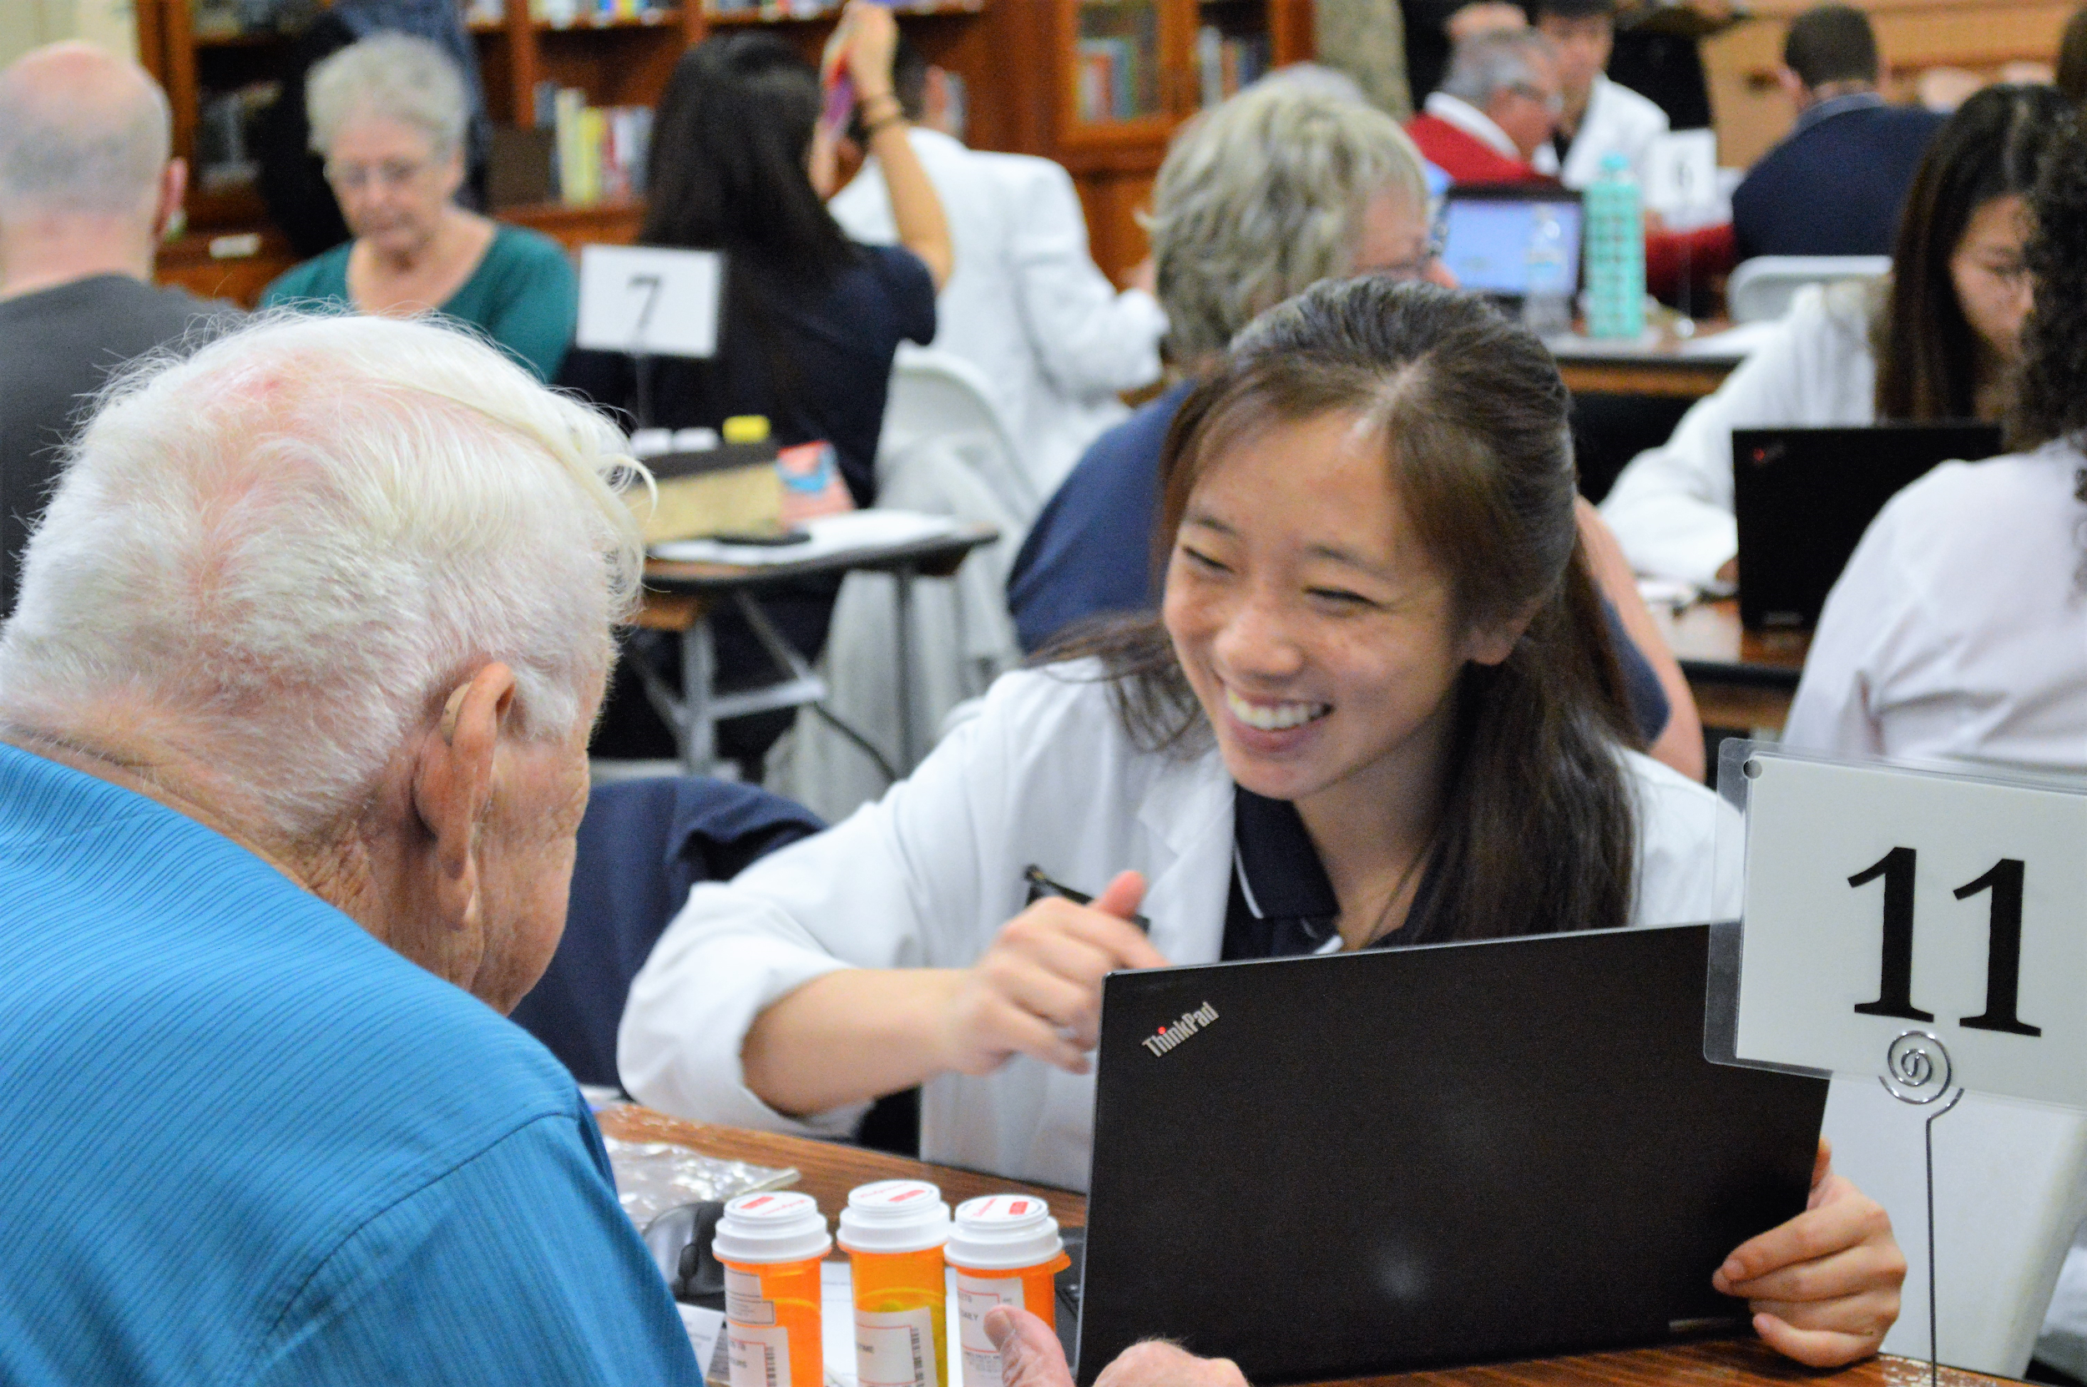
Want to get involved?
Shadow student pharmacists working under pharmacist supervision
Serve as Translators*
Spread the word about our events in your local community!

Slide 14
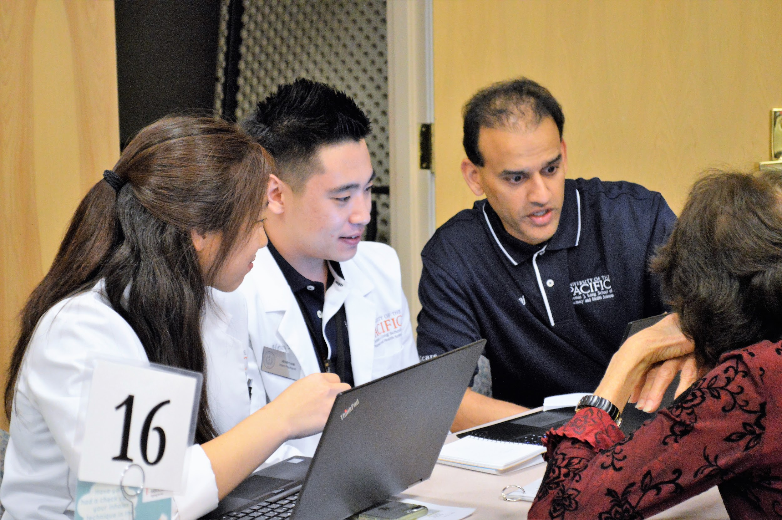
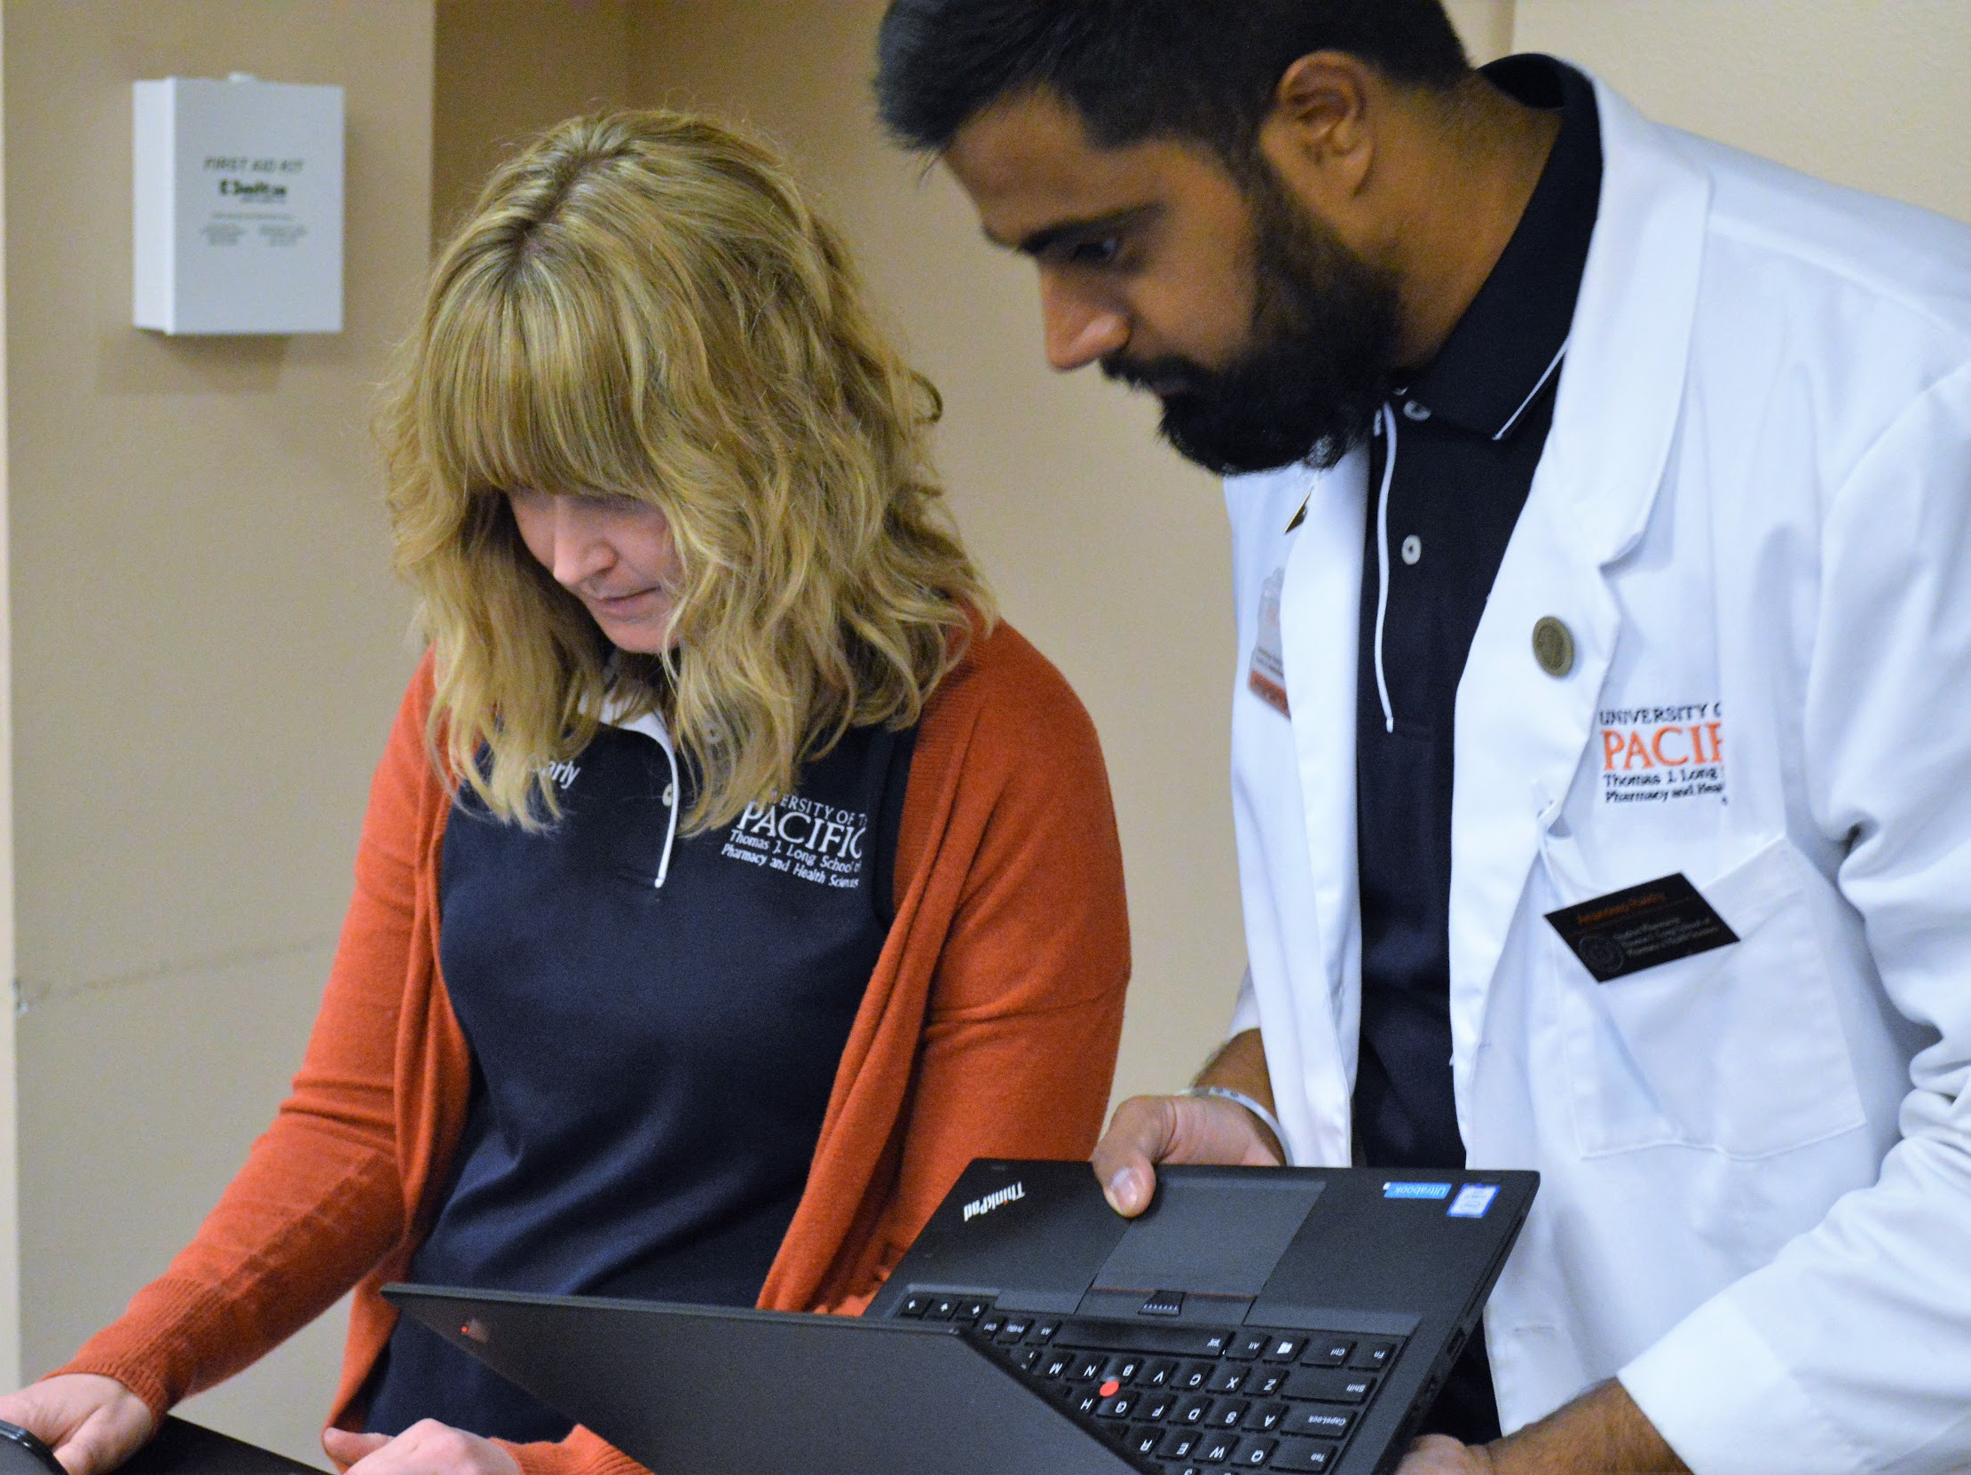
What you can expect…
Sit and learn with us as we perform MTM/Medicare Part D interventions
Observe and learn about health care screenings and services
One-on-one time with a UOP faculty member
Understand what is possible as a student pharmacist!

Slide 15
2018 Mobile Medicare Clinics
Stockton
Saturday, October 20th UOP School of Pharmacy
10am-6pm
Tuesday, November 6th Sierra Vista Homes
1pm-5pm
Spanish translators needed
Friday, November 9th First Congregational Church
1pm-7pm
Sunday, November 18th O’Connor Woods
10am-6pm
Ripon
Saturday, November 3rd Bethany Home
10am-5pm

Slide 16
Lodi
Thursday, October 18th LOEL Senior Center
1pm-6:30pm
Thursday, November 15th Hutchins Street Square
1pm-6:30pm
Tracy
Friday, October 26th Tracy Community Center
1pm-6:30pm
Turlock
Saturday, October 27th Covenant Village of Turlock
10am-5pm
Sacramento
Saturday, November 17th Hart Senior Center
10am-4:30pm

Slide 17
San Jose
Sunday, October 21st Vietnamese Community Center
10am-5pm
Vietnamese speakers needed
San Francisco
Sunday, November 4th JCCSF
10am-4pm
Cantonese, Russian, Mandarin speakers needed
Pleasanton
Saturday, November 10th Stoneridge Creek
10am-5pm
Berkeley
Sunday, October 28th Ed Roberts Campus
10am-5pm

Slide 18
Come participate at our Mobile Medicare Clinics!
Deadline to Sign-Up: Three Days from Today
Please sign up using our Google form
Once notified that you have been chosen to participate you will need to complete the following (which will be provided to you):
HIPAA Training
Volunteer Form/Student Conduct Contract
Flu Vaccination (provided on site for free if needed)

Slide 19
Sign-Up Form
Link to Form
Link to Form

Slide 20
Contact Information
Christine Sahyouni: c_sahyouni@u.pacific.edu
Sabrina Mahal: s_mahal@u.pacific.edu
Camille Mayo: c_mayo@u.pacific.edu
Petrus Nguyen-Tu: p_nguyentu@u.pacific.edu
Kimberly Derreza: k_derreza@u.pacific.edu
Wajeeha Ahad: w_ahad@u.pacific.edu
Stephanie Anderson-Barroso: sbarroso@pacific.edu

