Slide 1
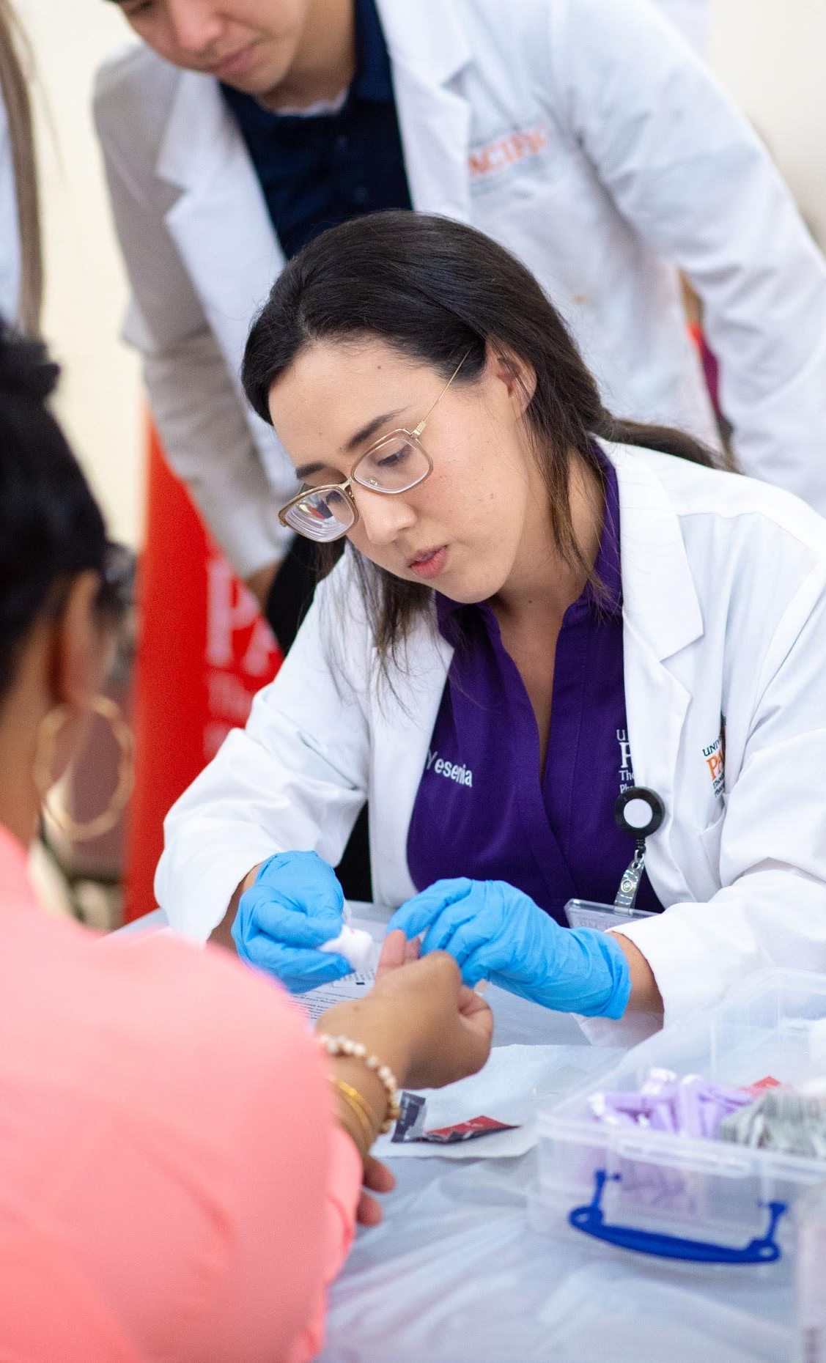
MOBILE MEDICARE CLINICS 2019
Yesenia Gutierrez & Carolyn Pak
University of the Pacific, Thomas J Long School of Pharmacy
Medicare Part D Outreach Class 2019

Slide 2
AGENDA
Introduction
Medicare 101
What We Do
Get Involved!

Slide 3
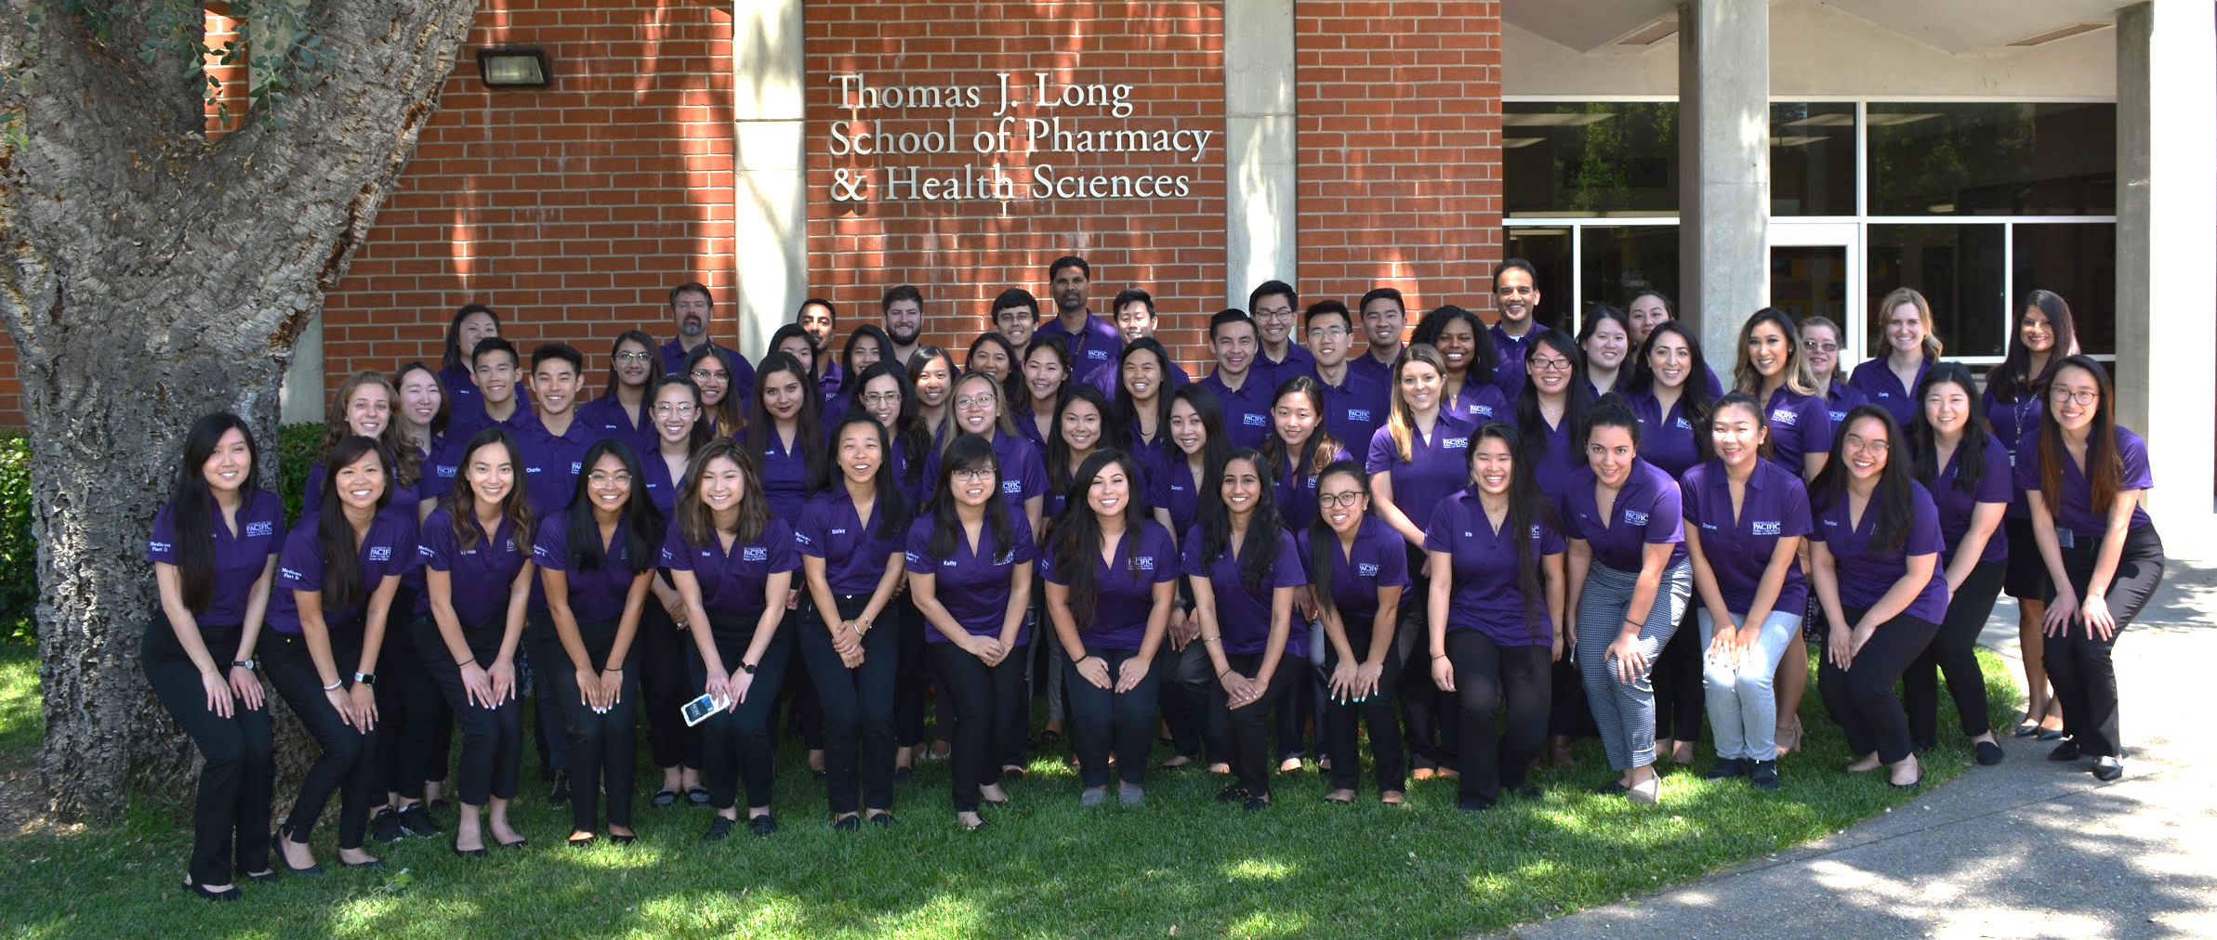
Who Are We?
Student Pharmacists at the Thomas J. Long School of Pharmacy and Health Sciences
Students enrolled in Medicare Part D Elective Course

Slide 4
What is Medicare?
A federal health insurance program that covers more nearly 60 million Americans through one out of these five criterias:
Age 65+
Permanently Disabled
End-Stage Renal Disease
Amyotrophic Lateral Sclerosis (aka Lou Gehrig’s Disease)
Exposed to Environmental Health Hazards

Slide 5
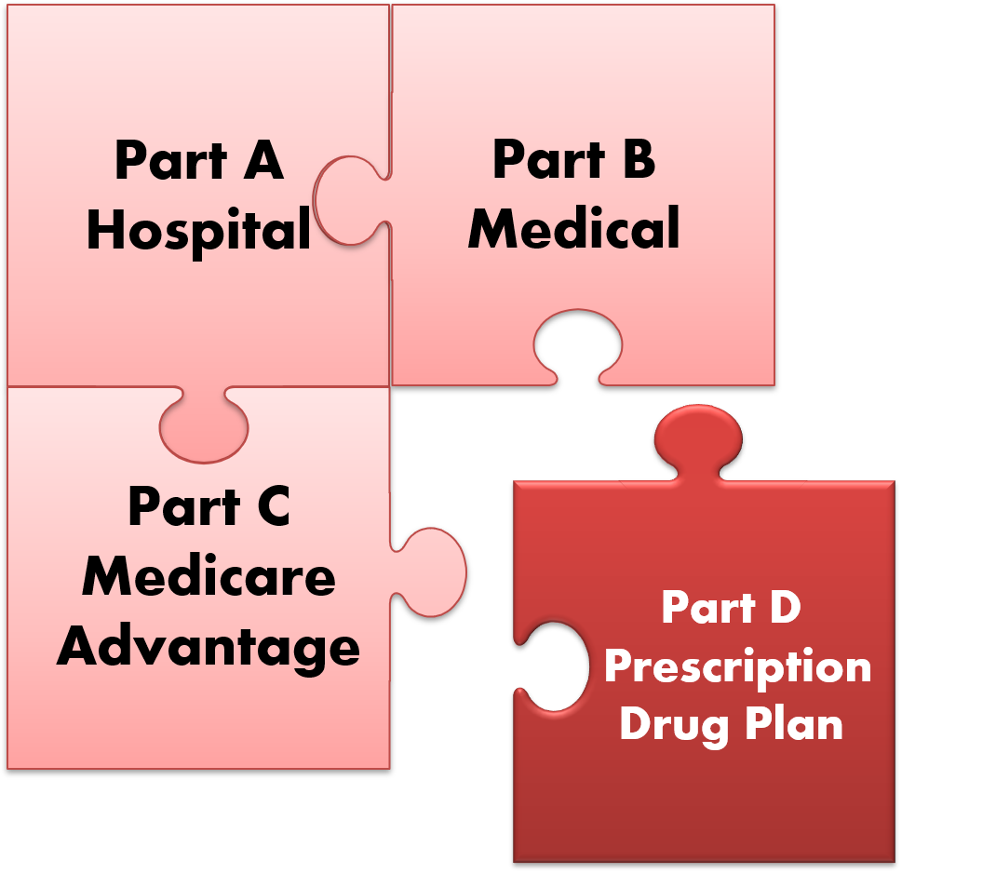
The Parts of Medicare

Slide 6
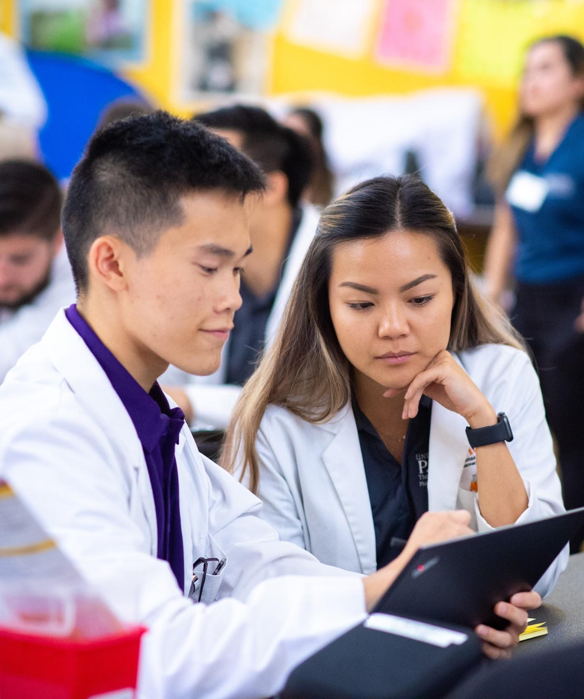
What We Do
Medicare Part D Plan Optimization
Potentially save them money on their prescription costs
Medication Therapy Management (MTM)
Evaluate all of their medications for safety and effectiveness
Increase engagement and understanding
Health screenings/services
Notes:
.

Slide 7
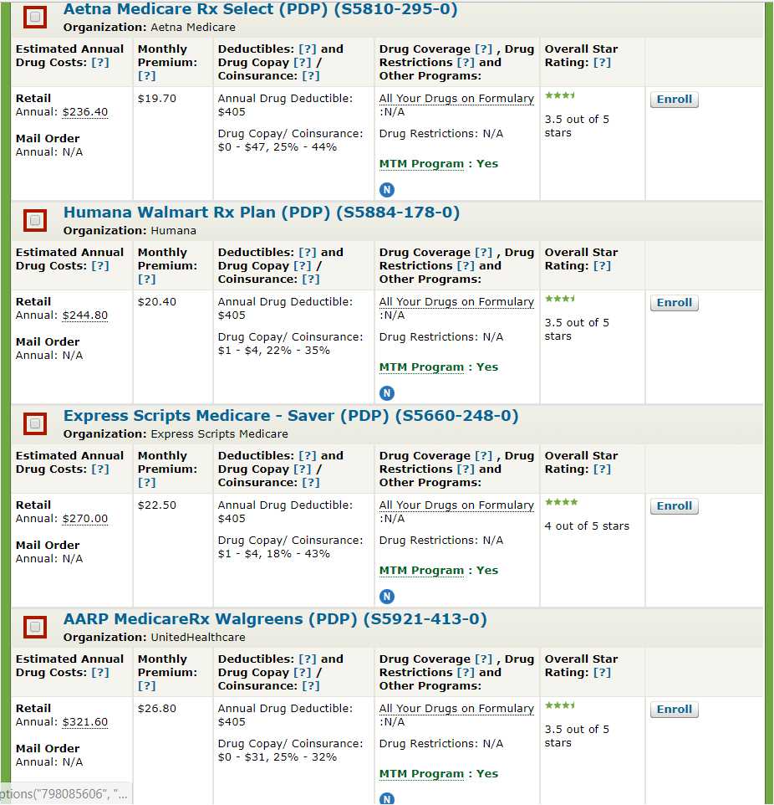
Medicare Part D
Many aspects of each Part D plan changes annually
Premium
Deductible
Formulary
Cost-sharing structure (e.g.,co-pays)
Drug utilization requirements

Slide 8
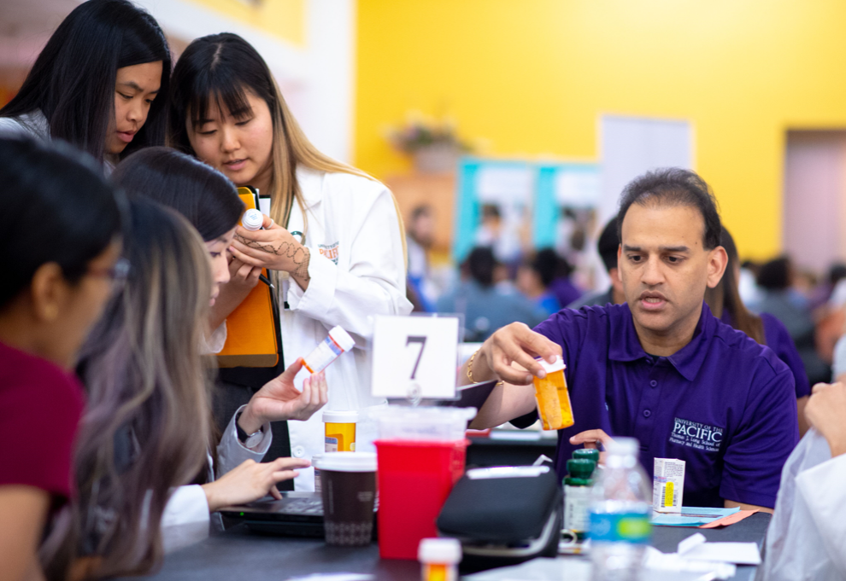
Medication Therapy Management (MTM) Services
MTM Review
Side effects
Adherence
Education
Efficacy
Duplicate therapy
Drug-Drug Interactions
Prescriber follow-up
Personalized Medication Record

Slide 9
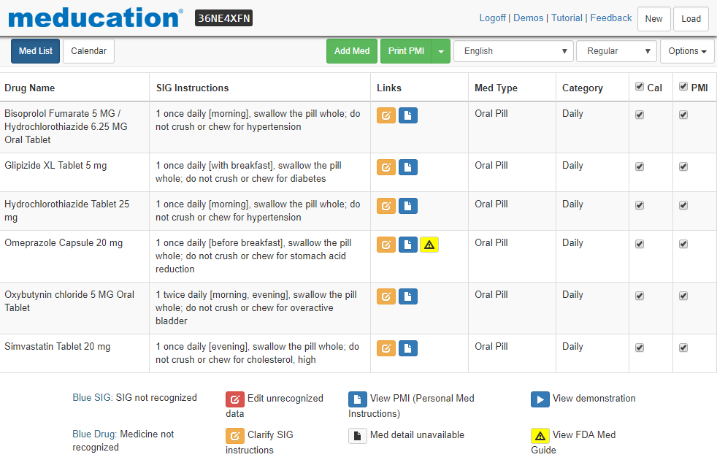

Slide 10
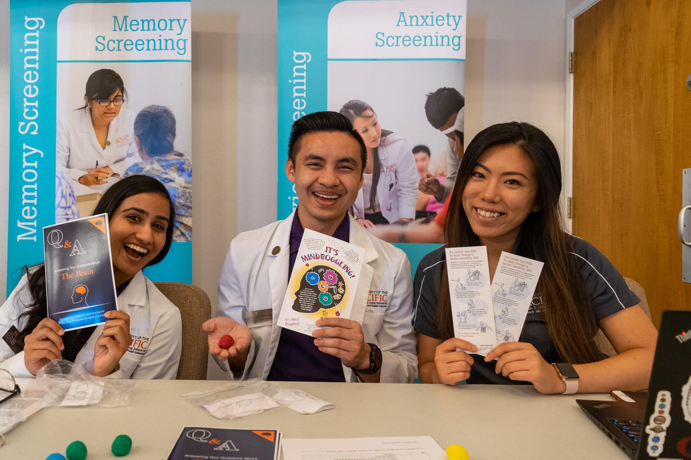
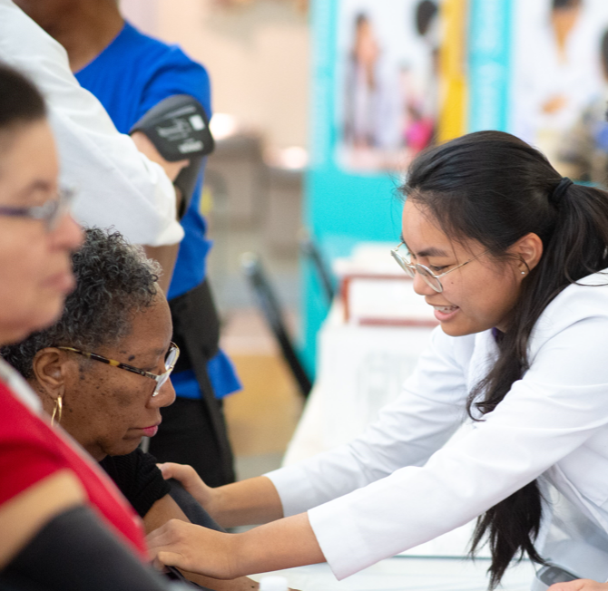
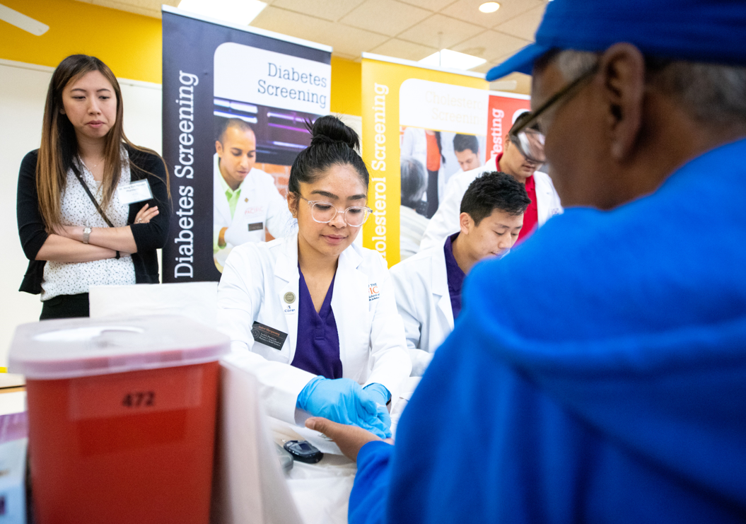
Health Services/Screenings
Immunizations
Asthma and COPD
Bone Density
Blood Pressure
Cholesterol
Diabetes
Memory
Depression
Falls Risk Assessment
Anemia
Anxiety
Sleep disorders
Medication/Sharps disposal
Narcan

Slide 11
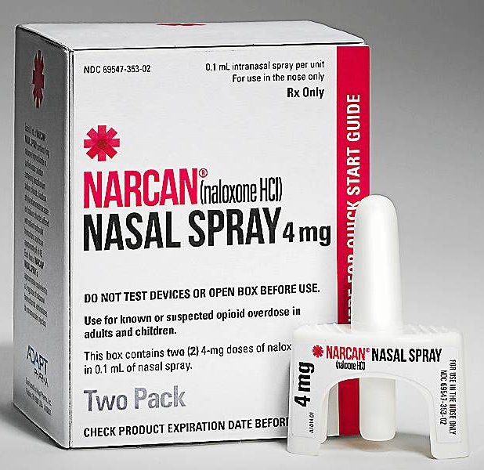
Narcan Kit Distribution
The Medicare class at UOP will be dispensing a drug called Naloxone (Narcan)
Naloxone can be used to reverse opioid induced respiratory depression
Administered via an intranasal spray in the event of an accidental overdose

Slide 12
Opioids: What are they?
Opioids are a class of drugs that include:
Heroin (Schedule I)
Fentanyl, oxycodone, hydrocodone, codeine, and morphine (prescription opioids)
Prescription opioids are mostly used to treat moderate-severe pain
Potential for abuse and misuse

Slide 13
Why are we doing this?
The Opioid Crisis
In 2017 there was a total of 191 million opioid prescriptions dispensed in the U.S.
In 2017, Alameda County dispensed 759,873 opioid prescriptions
From this total there were:
144 hospitalizations
35 deaths due to opioid overdose

Slide 14
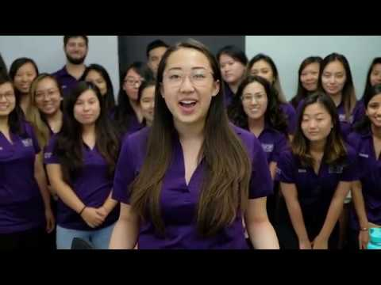
See Us in Action!
Notes:
Link the video

Slide 15
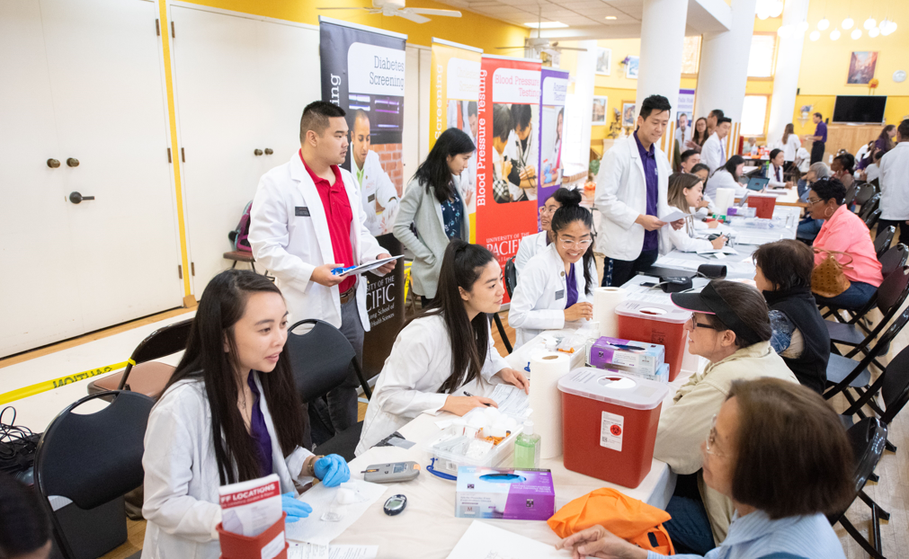
Get involved!
Shadow student pharmacists working under pharmacist supervision
Serve as Translators*
Spread the word about our events in your local community!

Slide 16
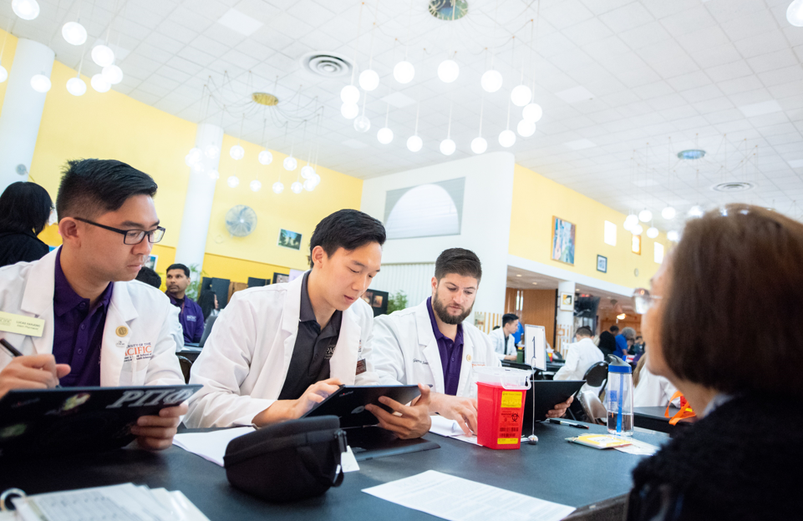
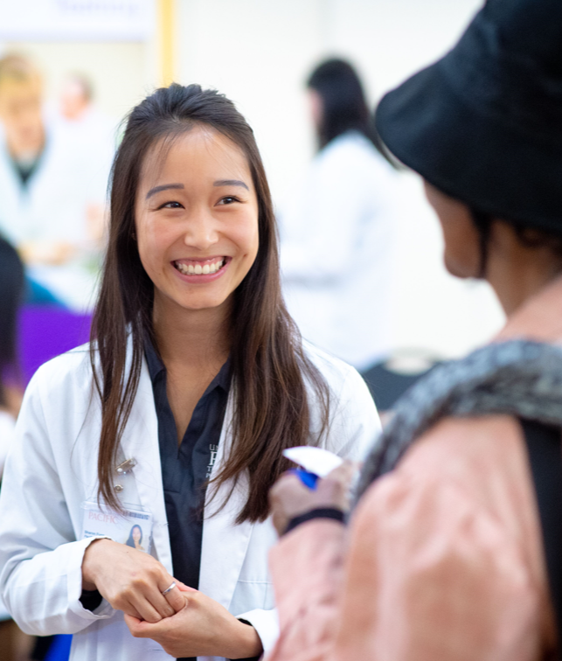
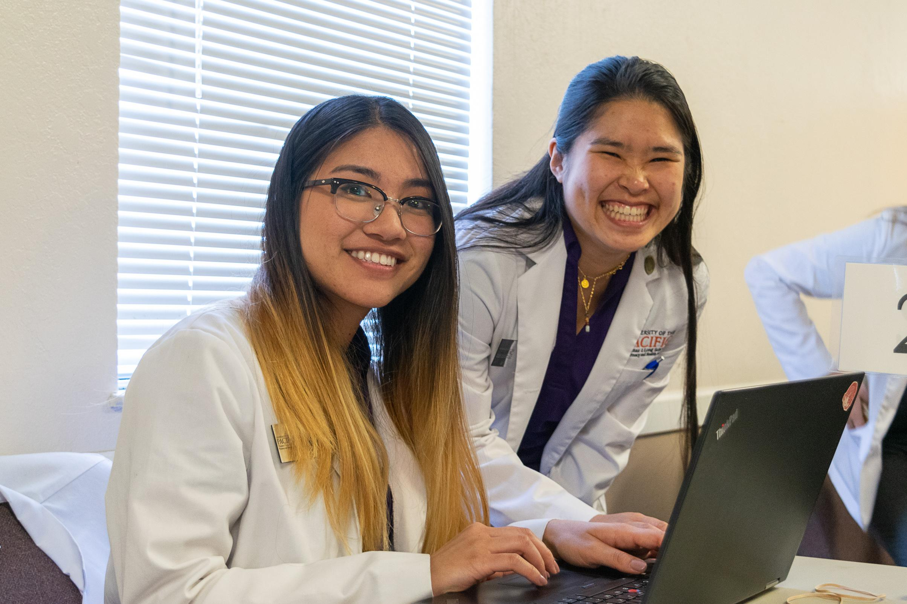
Get Involved!
Sit and learn with us as we perform MTM/Medicare Part D interventions
Observe and learn about health care screenings and services
One-on-one time with a UOP faculty member
Learn more about your future career path as a pharmacist!

Slide 17
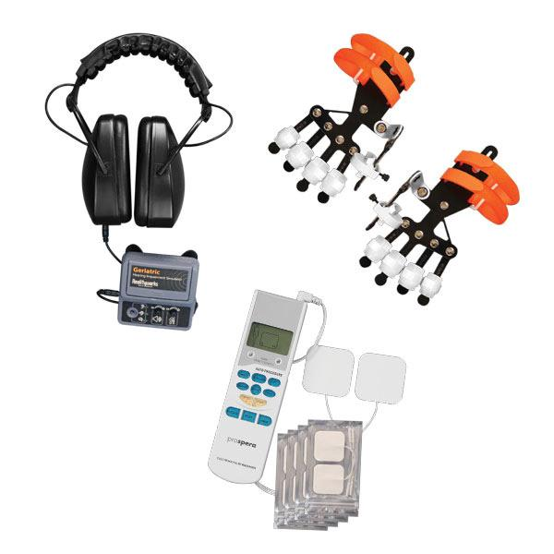
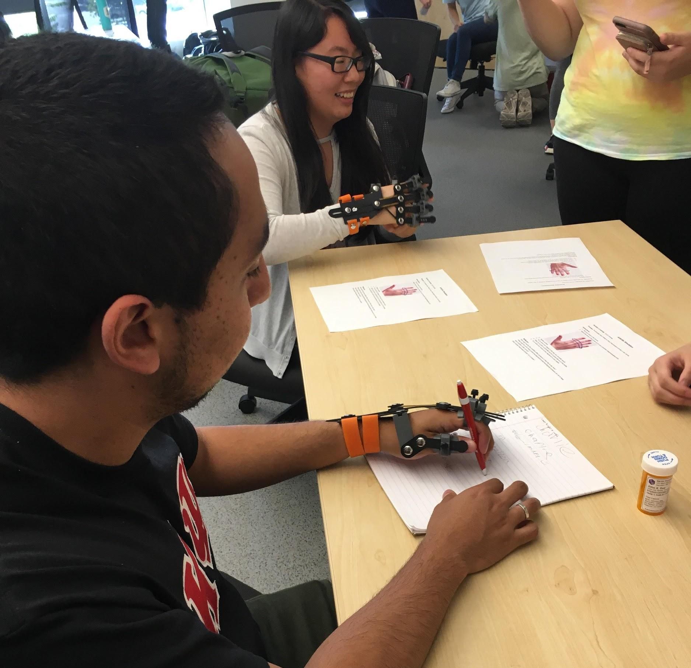
Geriatric Simulation Activity
Simulate common bodily changes, such as vision and mobility problems that geriatric patients often acquire as they get older, which decreases their quality of life
Activities
Arthritis simulation
Tremor Simulation
Medication management
Visual Impairments
Hearing Impairments

Slide 18
2019 Mobile Medicare Clinics
Stockton
Saturday, October 19th UOP School of Pharmacy
10am-6pm
Tuesday, November 5th Sierra Vista Homes
1pm-5pm
Spanish translators needed
Sunday, November 17th O’Connor Woods
10am-6pm
Tuesday, November 19th First Congregational Church
1pm-7pm
Ripon
Saturday, November 9th Bethany Home
10am-4pm

Slide 19
Lodi
Thursday, October 17th LOEL Senior Center
1pm-6:30pm
Thursday, November 14th Hutchins Street Square
1pm-6:30pm
Tracy
Tuesday, October 22nd Tracy Community Center
1pm-5:30pm
Turlock
Saturday, October 26th Covenant Village of Turlock
10am-5pm
Orangevale
Sunday, November 3rd Orangevale Community Center
10am-5pm

Slide 20
San Jose
Saturday, November 16th Most Holy Trinity Church
10am-5pm
Vietnamese speakers needed
San Francisco
Sunday, November 10th JCCSF
10am-4pm
Cantonese, Russian, Mandarin speakers needed
Pleasanton
Saturday, November 2nd Stoneridge Creek
10am-6pm
Berkeley
Sunday, October 27th Ed Roberts Campus
10am-5pm

Slide 21
Come participate at our Mobile Medicare Clinics!
Deadline to Sign-Up: One Week from Today
Please sign up using our Google form
Once notified that you have been chosen to participate you will need to complete the following (which will be provided to you):
HIPAA Training
Volunteer Form/Student Conduct Contract
Flu Vaccination (provided on site for free if needed)

Slide 22
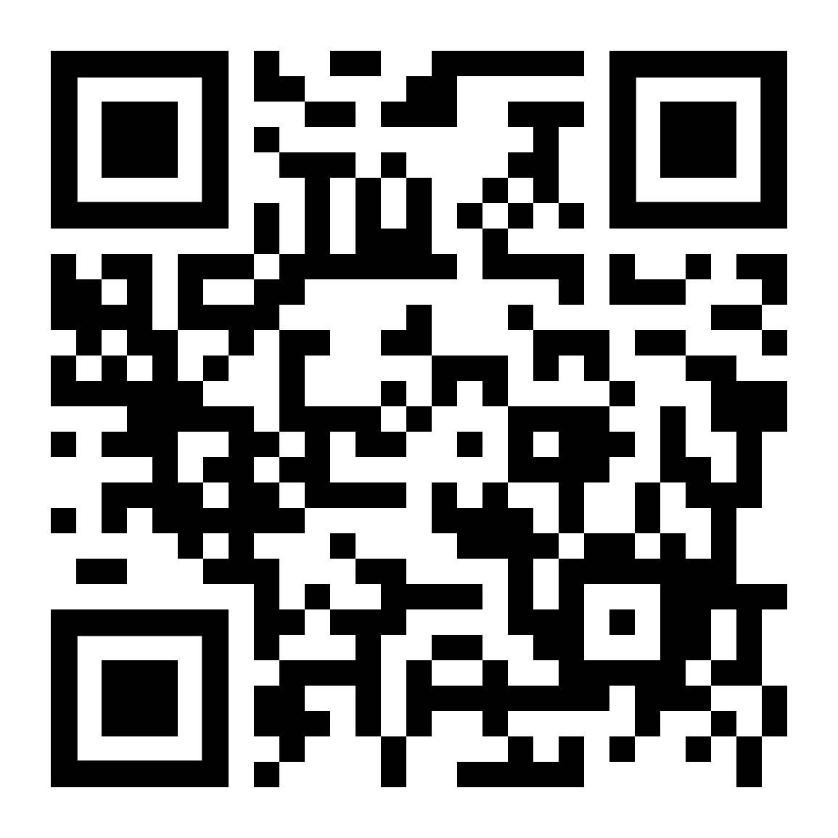
Sign-Up Form
Link to Form

Slide 23
Contact Information
Sharon Cheung: s_cheung8@u.pacific.edu
Yesenia Gutierrez: y_gutierrez5@u.pacific.edu
Hermelinda Avila Mendez: h_avilamendez@u.pacific.edu
Carolyn Pak: c_pak@u.pacific.edu
Kathy Pham: k_pham30@u.pacific.edu
Genaro Solorio: g_solorio1@u.pacific.edu

