Slide 1
Writing a Winning Resume

Slide 2
Agenda
Purpose of a Resume
Format
Sections
Things to Avoid

Slide 3
What is the Purpose of a Resume?
It’s your personal marketing tool to get you an interview. It can also be used to help you network and connect

Slide 4
Please note! Resumes vary by country
GoinGlobal International Careers Guide - career, employment, and job search information for over 25 countries and an employer directory containing 1000’s of company listings
*available in the Resources section of Handshake
Notes:
This workshop focuses on resumes in the US, if you are seeking information on writing resumes for employement abroad please use “GoinGlobal” in the resource section of Handshake.

Slide 5
-RESUME FORMAT-
Notes:
As an undergrad/new grad, the education section should come first as it is the most recent and relevant. Eventually, you can drop this section down to the bottom of your resume.

Slide 6
Preferred Format - Chronological
The most relevant and important information should appear first
Needs to be easy to read and scan
Within each section dates should be listed in reverse chronological order (present to past)
Not writing an essay, margins can be very small
11 point font is best, don’t go smaller than 10

Slide 7
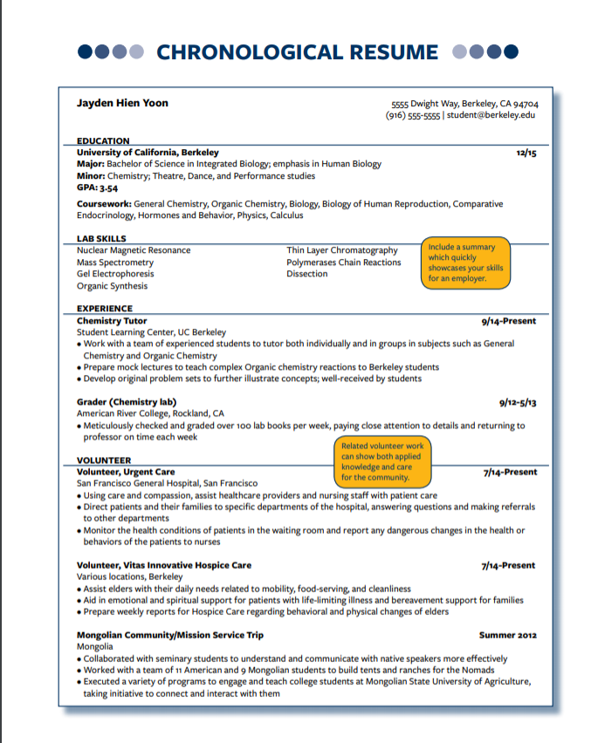

Slide 8
-SECTIONS of a RESUME-
Notes:
As an undergrad/new grad, the education section should come first as it is the most recent and relevant. Eventually, you can drop this section down to the bottom of your resume.

Slide 9
-EDUCATION-
Notes:
As an undergrad/new grad, the education section should come first as it is the most recent and relevant. Eventually, you can drop this section down to the bottom of your resume.

Slide 10
Sample of Basic Format
University of California, Berkeley December, 2020
Bachelor of Science: Civil & Environmental Engineering, GPA 3.15

Slide 11
Sample with Honors, Coursework, Transfer Institution & Study Abroad
University of California, Berkeley May 2020
Degree: B.A. Applied Mathematics, GPA 3.86
Honors: Dean’s Honor List, National Merit Scholarship Winner
Coursework: Data Structures and Programming Methodology, Concepts in Computing with Data, Discrete Mathematics
UC Education Abroad Program, Peking University June-July 2019
Improved language skills and cross cultural communication
Developed global awareness and increased flexibility
Chabot Community College, Hayward, CA August 2016-May 2018
Coursework: General Education
Notes:
If you are a transfer student you can also add your transfer institution.

Slide 12
Sample with Thesis & Projects
University of California, Berkeley May 2020
B.A. Political Science; minor Ethnic Studies, GPA 3.7
Senior Thesis: “Voter awareness among California Latino youth in low-income urban neighborhoods”
Relevant Research Project: “Comparative Urban Analysis: New York vs. Chicago”
Researched the political and development histories of two major U.S. cities; identified and reference 8 professional sources. Composed a 22 page research paper and presented findings to a class of 35 peers (The Politics and Policy of Metropolitan America – Fall 2009. Grade “A”)

Slide 13
-EXPERIENCE-

Slide 14
Experience: The heart of your resume
Includes jobs, internships, clubs, activities, etc.
Do not need to separate or note which experiences were paid and which were unpaid, unless you really want to highlight volunteer experience
Instead of having one long “Experience” section you can also break this down and have additional sections like “Projects,” “Research,” “Leadership” and “Activities” if you would like to draw attention to these aspects of your experience

Slide 15
Writing the bullets:
When writing descriptions try to avoid saying things like: “duties included” and “responsible for,” instead focus on highlighting your skills
Start each bullet with a skill or action oriented verb
Quantify and highlight your results, achievements, and impacts whenever possible

Slide 16
Examples:
PROJECTS
Design of Environmental and Water Resource Course, Fall 2020
Devised a water supply system in a fictitious town to provide potable water.
Designed a system that consisted of pipes, pumps, and a reservoir to transport water from one location to another.
Math, Engineering, Science Achievement (MESA) Program, Fall 2019
Planned, designed, and constructed a wheelbarrow storage for the community of the Homeless Garden Project.
Observed the client’s concerns and needs and examined all possible solutions.
Built the most favorable design within the allocated $500 budget.

Slide 17
Examples:
RESEARCH EXPERIENCE
Research Assistant Spring 2020
Psychology Department, UC Berkeley
Managed team of four behavioral coders for project investigating age differences in emotion
Attended weekly team meetings to assess progress, discussed coding methods, and relevant articles
Made over 40 calls to survey, recruit, and schedule potential participants
Research Assistant Fall 2018-Fall 2019
Comparative Endocrinology Lab, UC Berkeley
Plan, organize, and carry out short and long term research projects
Analyze, research, and study evolution of hormones
Developed expertise in metabolic pathways of thyronines

Slide 18
Examples:
LEADERSHIP EXPERIENCE
Development Chair August 2018 - Present
Women’s Pre-Law Organization, UC Berkeley
Initiate contact with 5-7 campus liaisons per semester to coordinate bi-annual fundraising events. Attendance rose from 85 to over 120
Increased yearly organization fund from $1,800 to $3,000 through alumni donor development and fundraising events
Collaborate with Outreach Chair and Club President to coordinate monthly organizational field trips to law firms

Slide 19
Examples:
ACTIVITIES
Rower, Lightweight Crew Team, UC Berkeley 8/18-1/20
Participated in year round competitive intercollegiate rowing club, practicing 20 hours per week
Taught new members technique and helped motivate them during practices and competitions
-OR-
Saxophone, UC Berkeley Jazz Band 1/18-Present
Rower, Lightweight Crew Team, UC Berkeley 8/17-1/18

Slide 20
Attributes Employers Seek:
Leadership
Ability to work in a team
Communications skills (both written and verbal)
Problem solving skills
Strong work ethic
Initiative
Analytical/quantitative skills
Flexibility/adaptability
Interpersonal skills
Technical/computer skills
Detail oriented
Notes:
These are attributes that all employers value so whenever possible try to highlight and incorporate them into your experiences

Slide 21
Action Words to Use
Management Skills: Achieved Analyzed Assigned Attained Chaired Conceived Consolidated Coordinated Decided Encouraged Improved Incorporated Increased Inspired Launched Managed Outlined Produced Recommended Reevaluated Reported United
Communication Skills: Arbitrated Arranged Authored Collaborated Convinced Counseled Defined Developed Directed Drafted Edited Enlisted Formulated Influenced Mediated Moderated Motivated Negotiated Persuaded Promoted Reconciled Recruited Renegotiated Reported Researched Spoke Translated
Research Skills: Clarified Collected Conceived Critiqued Detected Diagnosed Disproved Evaluated Examined Extracted Identified Inspected Interpreted Interviewed Investigated Organized Reported Researched Searched Studied Summarized Surveyed Systematized Wrote
Technical Skills: Analyzed Assembled Built Calculated Computed Designed Devised Engineered Fabricated Inspected Maintained Operated Overhauled Programmed Remodeled Repaired Solved Trained Upgraded
Financial Skills: Adjusted Administered Allocated Analyzed Appraised Audited Balanced Budgeted Calculated Compared Computed Developed Estimated Forecasted Managed Marketed Planned Projected Reevaluated Researched
Creative Skills: Acted Applied Composed Conceived Created Customized Conceptualized Designed Developed Directed Established Evaluated Fashioned Formed Formulated Founded Illustrated Initiated Instituted Integrated Introduced Invented Originated Performed Planned Produced Projected Refined Researched Revitalized Rewrote Shaped Updated
Helping Skills: Advised Aided Assessed Assisted Brought Coordinated Counseled Demonstrated Diagnosed Educated Encouraged Enlisted Expedited Facilitated Familiarized Guided Helped Inspired Maintained Modified Motivated Performed Referred Rehabilitated Represented Supported Upheld
Detail Oriented Skills: Arranged Compiled Described Edited Estimated Executed Generated Implemented Maintained Monitored Observed Operated Organized Prepared Proofread Recorded Screened Systematized Tabulated Validated
Notes:
These are attributes that all employers value so whenever possible try to highlight and incorporate them into your experiences

Slide 22
Be specific and show your skills
Example #1:
Before: Created a brochure
After: Created marketing brochure using InDesign to generate greater customer interest in the company’s new fall line of clothing; highly praised by the Director of Marketing

Slide 23
Show and Share Specifics
Example #2:
Before: Tutored Students
After: Tutored at-risk youth in Math and English; assessed learning styles of each student and adjusted tutoring style based on results; Achieved grade improvement in 100% of all students tutored over a three month period

Slide 24
-SKILLS & INTERESTS-

Slide 25
May include a skills section up towards the top of the resume if you have specific skills that are very relevant to the position that you are applying too.
LAB SKILLS
Nuclear Magnetic Resonance
Mass Spectrometry
Gel Electrophoresis
Organic Synthesis
Polymerases Chain Reaction
Dissection

Slide 26
Otherwise, this section is typically included at the bottom of your resume.
SKILLS & INTERESTS
Computer: C++, HTML, Excel, Access, PowerPoint, Word
Languages: Fluent in Mandarin
Interests: Avid vocalist, painter and photographer
Notes:
-Can divide up the sections to make it easier to read and scan
-avoid listing soft skills like teamwork, interpersonal and leadership skills, because there is no context there is no impact. It’s better to demonstrate these skills in your experience section.
list skills in the order of most relevant and important
Interests can be anything you feel comfortable sharing. Sharing interests may be a way of connecting with an interviewer or showing a different side of yourself.

Slide 27
CV or Resume?
What’s the difference?
Notes:
-Can divide up the sections to make it easier to read and scan
-avoid listing soft skills like teamwork, interpersonal and leadership skills, because there is no context there is no impact. It’s better to demonstrate these skills in your experience section.
list skills in the order of most relevant and important
Interests can be anything you feel comfortable sharing. Sharing interests may be a way of connecting with an interviewer or showing a different side of yourself.

Slide 28
-RESUME DONT’S-

Slide 29
Exceed a page
Have any typos
Embellish your experiences
Compare yourself to your peers- be you!

Slide 30
Questions?

Slide 31
Follow Us on Social Media
@calcareercenter
@calcareercenter
https://www.facebook.com/CalCareerCenter/

