Slide 2
https://pharmacyschool.usc.edu/
John Stauffer Pharmaceutical Sciences Center is headquarters for the USC School of Pharmacy

Slide 3
https://pharmacyschool.usc.edu/
John Stauffer Pharmaceutical Sciences Center is headquarters for the USC School of Pharmacy

Slide 4
Curriculum
Four-year curriculum
12 - 18 units per semester
Introductory Pharmacy Practice Experience
Advanced Pharmacy Practice Experience
INFORMATIONSESSION

Slide 5
2017
USC School of Pharmacy Graduating Student Survey
Professions that you had the chance to participate or interact in required educational activities

Slide 6
2017 Graduating Student Survey Summary Plans for primary employment upon graduation

Slide 7
Top companies that hired from 2015-2017

Slide 8
USC School of Pharmacy U.S. Alumni Network

Slide 9
Worldwide USC School of Pharmacy Alumni Network 10,000 Strong

Slide 10
HEALTH SYSTEMS AND CARE MANAGEMENT
PUBLIC AND INTERNATIONAL HEALTH
COMPREHENSIVE MEDICATION MANAGEMENT
AND HIGH-RISK POPULATIONS
EDUCATION
PHARMACEUTICAL INDUSTRY
RESEARCH
PHARMACY ENTREPENEURSHIP

Slide 11
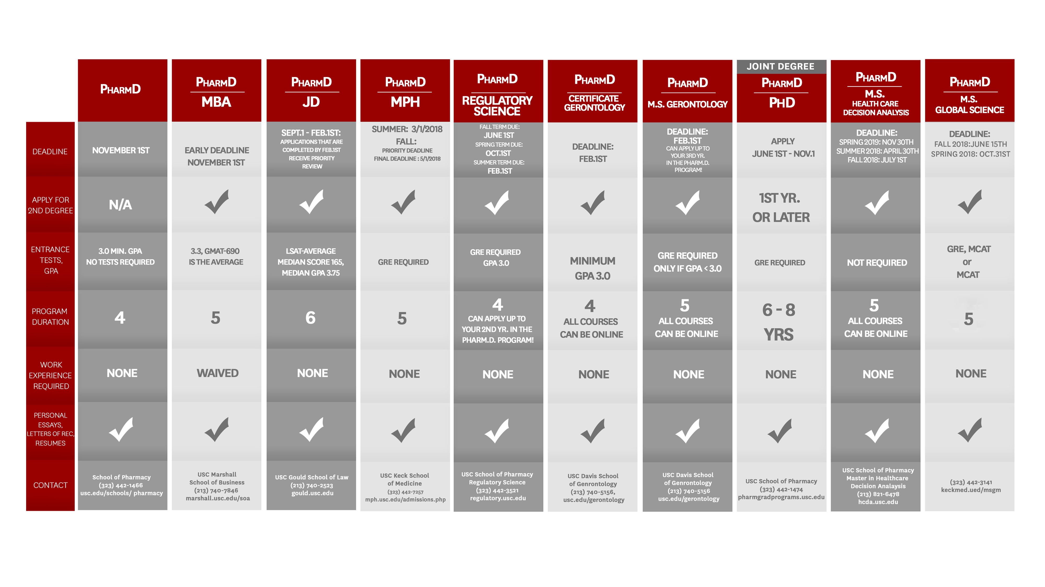

Slide 12
ADMISSION REQUIREMENTS
A bachelor’s degree is required.
Minimum 3.0 cumulative GPA & Pre-req GPA
Pre-pharmacy required courses must be completed before entering PharmD program with a grade of “C” or higher
Transcripts and three letters of recommendation
No standardized tests (PCAT, GRE) required (PCAT will be required beginning 19-20 admission cycle)
Online/Distance learning, C/NC or P/NP courses
Mandatory Interview

Slide 13
All pre-pharmacy required courses must be taken for a letter grade and completed with a
grade of “C” or better
Recommended courses: Upper division Molecular Biology, Physics (thermodynamics and electromagnetism), Microeconomics, and Human Behavior in General Psychology, Introductory Sociology, or Cultural Anthropology.

Slide 15
How to Apply
www.PharmCAS.org
Application Deadline: December 3
USC Program Materials:
USC questions, essays, pre-pharmacy
required courses
AP report, documents to be signed
Rolling Admission
Submit Transcripts to PharmCAS
Academic Updates

Slide 16
Application Essays
1.Describe why you want to attend pharmacy school at USC
2. What unique, personal qualities and/or life experiences will you bring to our program? You may also include, if applicable, information that describes why your college transcripts or your resume does not adequately portray your past performance or your future promise as a pharmacist. If you changed your major or if you are changing careers, explain why you are now applying to pharmacy school

Slide 17
Interview
Mandatory Hybrid MMI Interview
Showcasing your soft skills, leadership ability, problem solving and your motivation or potential to be a pharmacist.
A one on one interview will also be part of this Hybrid MMI process.
INFORMATIONSESSION

Slide 18
Interview Dates
October 19, 2018
November 16, 2018
November 30, 2018
January 18, 2019
February 1, 2019
March 9, 2019
March 30, 2019

Slide 19
What major do you prefer?
What is the average GPA?
How do I improve my GPA?
How many students are accepted each year?
When do I expect to hear from you?
How to make changes after submitting my application?
Can I take pre-requite (pre-req) courses at community colleges?
Can I go over my transcripts with you?
When do I have to finish my pre-reqs?
Do you accept AP scores?
Do you waive any pre-reqs with work experience?

Slide 20
2018-2019 Cost of Attendance for New Students For students living off or on campus housing
Tuition |  |  |  |  | $ 56,846.00
Mandatory Fees
 | School of Pharmacy Fees |  |  |  | $ 650.00
 | Program Fee |  |  |  | $ 80.00
 | Health Center Fee |  |  |  | $ 698.00
 | Norman Topping Fee |  |  |  | $ 16.00
 | Health Insurance |  |  |  | $ 2,041.00
 | New Student Orientation |  |  |  | $ 55.00
Total |  |  |  |  | $ 60,386.00

Slide 21
Types of Aid
Pharmacy Health Profession Student Loan
Federal Unsubsidized Stafford Loan
Federal Graduate Plus Loan
Private Loan
Institutional and Endowed Scholarships
INFORMATIONSESSION

Slide 22
USC School of Pharmacy Scholarships
Must demonstrate leadership, community service, career interest and academic achievement
Amount varies from $2,500 and above
Deadline to apply will be announced each fiscal year
INFORMATIONSESSION

Slide 23
Information Sessions
August 24, 2018
September 14, 2018
October 5, 2018
February 22, 2019
April 5, 2019

Slide 24
Thank You!
Niya Tanyi
Admission Recruiter
(818) 669-5047
tanyi@usc.edu

