Slide 1
Last Chance Summer Research Opportunities Workshop
Spring 2009

Slide 2
Welcome
If you would like a copy of this PowerPoint presentation, simply visit our website, where it will be available for download:
http://www.ocf.berkeley.edu/~ugsa/
Please send any questions you have to calugsa@gmail.com

Slide 3
Overview
Introduction
How to find a research position
A look at one person’s experience
UGSA summer apprenticeship application
Question and answer

Slide 4
Finding a research position

Slide 5
Location
Determine where you would like to work this summer
With summer coming up so soon, you may need to consider working at UC Berkeley or working near home

Slide 6
Finding a professor
Look at universities near where you want to be
Look at fields that are interesting to you and are related to your career plans
Don’t be afraid to look outside of these fields as well!

Slide 7
Doing your homework
Go online to determine a short list of professors you would like to work with
Take a look at the research they do, particularly recent work

Slide 8
Contacting them
If possible, seek out faculty at their office hours, otherwise, email or call them
Give them general information about yourself and why you want to do research
Be specific, have a research project in mind and talk to them about it
Market yourself: offer to work for free, offer to do menial work

Slide 9
Alternatives
Seek out graduate students and post-docs who are working on specific projects
Look at companies who are researching things you are interested in
Networking is key, don’t hesitate to ask friends who already have positions to ask around for you (professors can be friends too)

Slide 10
Research Experience
with Austin

Slide 11
UGSA Apprenticeships
The Application

Slide 12
About the program
These opportunities are available exclusively through UGSA.
The application and more detailed descriptions of each lab’s research projects can be found at our website:
http://www.ocf.berkeley.edu/~ugsa/

Slide 13
How to apply
Fill out an application form from our website
Applications are due 11 PM Friday, April 24th, e-mailed to calugsa@gmail.com as a word document
Resume is optional, it can’t hurt your chances
UGSA will forward all applications to each professor
Professors will directly contact applicants whom they are interested in, either for an interview, or for a direct selection. Please refrain from contacting professors unless they first contact you.

Slide 14
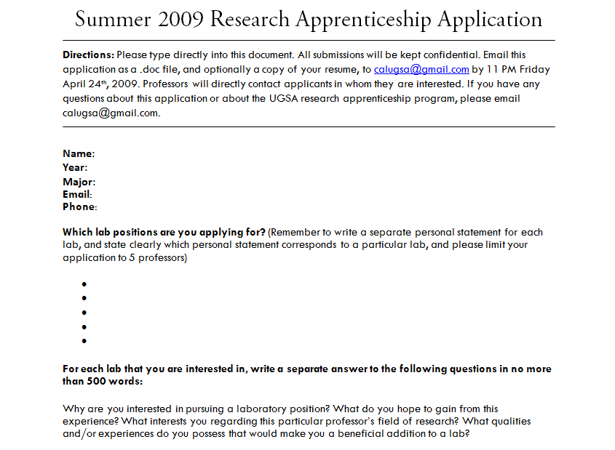

Slide 15
Lawrence Berkeley National Lab
Seng Lab
nuclear medical imaging and radiation detection and instrumentation
Jr/Sr’s and Physics or EECS majors prefered
Kyrpides Lab
Computational molecular biology
Wyrobek Lab
Mutagenesis and gene expression risk factors for cancer and birth defects

Slide 16
Lawrence Berkeley National Lab
Gullberg Lab
Radiotracer Development and Imaging Technology
Better Diagnoses of cardiovascular diseases
Chen Lab
Various McB-related research
http://microarray.lbl.gov/frank_chen.htm
Tsai Lab
Expression and Molecular Biology
“Get into DNA Repair!”

Slide 17
Lawrence Berkeley National Lab
Auer Lab
A lot of stuff…nice guy.
http://www.lbl.gov/lsd/People_&_Organization/Scientific_Staff_Directory/Auer_Lab.html
Pluth Lab
Effects of spce radiation on DNA and repair mechanisms
Hoping for a two year commitment

Slide 18
University of California, San Francisco
Majumdar Lab
Developing quantitative imaging and image processing techniques to study the morphology and function of the musculoskeletal system.
Reichart Lab
Biochemical or imaging project studying synapse formation in neuronal cultures and/or sections of mouse brain.
Are looking at roles of BDNF, a trophic factor, and cell adhesion molecules in this process.

Slide 19
University of California, San Francisco
Verkman Lab
Water transport mechanisms across cell membranes through aquaporins; the study of biophysics of movements of solutes and interactions of the cell using FRAP; and the drug discovery and mechanisms of cystic fibrosis
Looking for a physics/math major to help with computer model systems
Habelitz Lab
preventive and restorative dental science
Burlingame Lab
mass spectrometry to study epigenetic modulation and regulation (changes in gene expression without changes to the DNA sequence) of mammalian and human proteomes

Slide 20
University of California, Irvine
Weiss Lab
Cal Alumnus!
http://chem.ps.uci.edu/~gweiss/
Establishing physical models for certain biological systems
Another Lab
Info will be on website

Slide 21
Questions
Breakout Session

Slide 22
Questions
How to approach a professor (front)
Willis
Austin
Stephanie
Where to look for an internship (left)
Whitney
Questions about our application (right)
Andrew
Miscellaneous + Questions about UGSA (back)
Victoria

