Slide 1
Behavioral Activation and Activity Scheduling

Slide 2
Concept of Behavioral Activation
Clients’ life circumstances have decreased their ability to gain positive reinforcement from their environment, leading to depression
To alleviate depression, the therapist helps the client to:
Increase behaviors that are positively reinforcing
Decrease behaviors that are negatively reinforcing

Slide 3
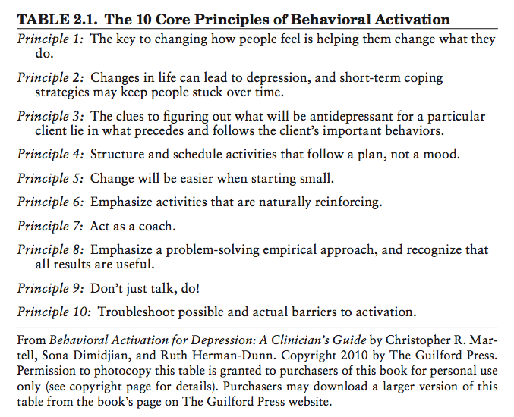
Core Principles of Behavioral Activation

Slide 4
Depression and Behavior
Depression decreases motivation
Clients often withdraw from activities that provide sense of pleasure and/or mastery
Clients often increase passive activities that maintain dysphoria (e.g. staying in bed, watching TV, playing video games)
Vicious cycles are likely to occur

Slide 5
Presenting Behavioral Activation to Clients
Review the cognitive model, focusing on behaviors:
What we do affects what we think and how we feel
By changing what we do, we can change how we feel
The way to get over a cold is to rest. The way to get over depression is the opposite – being active!

Slide 6
Presenting Behavioral Activation to Clients
Depression is characterized by a decrease in wanting to do activities, not by a decrease in enjoying those activities
Possible reasons people experiencing depression feel better when they are active:
Some activities (e.g. walking) release brain chemicals that enhance sense of wellbeing
Inactivity provides an opportunity to fixate on negative thoughts
Activities provide sense of pleasure and/or mastery

Slide 7
Acting from the “Outside-In”
People typically act when they experience an inner motivation to do so – acting from the “inside-out”
“BA therapists encourage people to begin acting from the ‘outside-in.’ We ask people to experiment with acting according to a goal, as opposed to acting according to a mood…to begin to act, even when mood and motivation are low, rather than waiting for one’s mood to improve prior to getting engaged.”
- Christopher R. Martell, Soma Dimidjian, Ruth Herman-Dunn, Behavioral Activation for Depression: A Clinician’s Guide

Slide 8
Acting from the “Outside-In”
From Martell, Dimidjian, & Herman-Dunn’s Behavioral Activation for Depression:
Clients may think it is “fake” to act from “outside-in”
It may be helpful to share this metaphor:
Imagine someone who has broken her right arm. She has to do daily tasks with her left arm for the time being. At first it she is clumsy using only her left arm, but over time it becomes easier. Then, once she heals, she is able to use both arms again.

Slide 9
Assessment
Some clients are engaged in passive behaviors that are used (likely ineffectively) to avoid negative thoughts and feelings
Some clients are engaged in active behaviors but are not experiencing enjoyment because they are consumed by negative thinking
Assess to determine which tools will be most useful (activity scheduling, NAT forms, etc.)

Slide 10
Examining the Client’s Schedule
Ask client to record their activities for the week, including ratings for mood and/or mastery and pleasure
Review with the client, asking:
Which activities are lowest in mastery and pleasure?
Which activities are highest in mastery and pleasure?
Is there a balance of mastery and pleasure?
Look for patterns in behaviors and associated moods
Identify vicious cycles
Explore how the current schedule differs from when the client was not experiencing depression

Slide 11
Example

Slide 12
Example (cont.)
Activities with Highest Mastery/Pleasure Ratings: writing, painting, running on treadmill, socializing
Activities with Lowest Mastery/Pleasure Ratings: working, computer
Metaphor: Activities with high ratings are fruits and veggies, activities with low ratings are junk food
“How can we get more fruits and veggies into your diet?”

Slide 13
Activity Scheduling
Probe to find out:
Activities that give the client a sense of pleasure
Activities that give the client a sense of mastery
See pg. 213 of Mind Over Mood
Use an Activity Chart to schedule activities
See pg. 214 of Mind Over Mood
Start small and specific
Scheduled activities can be simple actions (e.g. brewing and savoring a cup of coffee)
Break a goal activity into manageable steps to start

Slide 14
Behavioral Experiments on Activities
Assess for NATs about potential activities
Use behavioral experiments to test negative predictions about activities
Ex. “I don’t have the energy to do [ACTIVITY]”
Ex. “My friends won’t want to hang out with me”
Ex. “I won’t have fun”

Slide 15
Rating Mastery and Pleasure
Establish a 0-10 “Mastery Scale” and/or “Pleasure Scale” with the client
Ask the client to predict their level of mastery and/or pleasure for an activity before doing it
Then, have the client rate their actual level of mastery and pleasure in doing the activity

Slide 16
Experiencing Enjoyment
Clients may express decreased enjoyment of an activity as compared to their enjoyment of the activity before experiencing depression
Encourage clients to compare their enjoyment of the activity to their current baseline

Slide 17
Common Challenges
Client does not do a planned activity
Use this as an opportunity to elicit negative thoughts
Break the activity down into smaller tasks, and have the client master each before attempting the full activity
Troubleshoot in session, revise as needed, and plan ahead
Client has a negative experience doing a planned activity
Use this as an opportunity to elicit negative thoughts
Acknowledge that some activities will not be immediately positively reinforcing (e.g. looking for a job) and devise ways for the client to give herself credit for doing them
Troubleshoot in session, revise as needed, and plan ahead

Slide 18
Common Challenges
Client can’t come up with any pleasurable activities to try
Provide a list of activities (several available online) and ask client to choose several that could be most enjoyable
Ask if a given activity is likely to make the client’s mood better or worse than baseline inactivity
Do a behavioral experiment

