Slide 1
Working with Core Beliefs
Adapted from Beck, Cognitive Behavioral Therapy 2nd ed.
and Greenberger & Padesky, Mind Over Mood

Slide 2
Agenda
Defining Core Beliefs
Identifying Core Beliefs
Developing New Core Beliefs
Questions
Notes:
For our agenda today, we’ll start by defining core beliefs for ourselves and for our clients
Next, we’ll touch on how to identify clients’ core beliefs
Then, we’ll cover how to work with clients to develop and strengthen new core beliefs
We’ll close with an opportunity to answer questions and – time willing – do some case consultation

Slide 3
What are core beliefs?
One’s most central beliefs about oneself, other people, and the world
Absolute, all-or-nothing statements
Ideas, not necessarily truths
Notes:
For starters, what are core beliefs?
Core beliefs are one’s most central beliefs about oneself, other people, and the world.
Core beliefs take the form of absolute, all or nothing statements.
Core beliefs are ideas, not necessarily truths. As such, they can be tested.

Slide 4
How do core beliefs show up in our lives?
Like sunglasses, our core beliefs color our worldview
We complex humans can hold multiple, even contradictory core beliefs
Our core beliefs can become activated or de-activated based on our experiences
Negative core beliefs tend to surface during times of stress or strong emotion
Notes:
How do core beliefs show up in our lives?
Like sunglasses or Instagram filters, our core beliefs color our worldview.
On this slide you can see an example of how two different core beliefs color the same experience very differently.
We humans are quite complex, and we can hold multiple, even contradictory core beliefs about ourselves, other people, and the world.
Our various core beliefs can become activated or de-activated based on our life experiences.
Negative core beliefs tend to surface during times of stress or strong emotion.
So, a person could hold the realistic core belief “I have strengths and weaknesses like all people” most of the time and hold the negative core belief “I’m a failure” when she is depressed.

Slide 5
How are core beliefs formed?
Core beliefs develop from an early age
As children, we are sponges – we absorb what we’re taught
“The sky is blue.” “2+2=4.” “Boys are better than girls.” “You’re worthless.”
As kids, we don’t have the skills to analyze what’s fact and what isn’t
As we mature, we develop more flexible thinking…but some beliefs stay absolute
We may still act as if these negative beliefs are 100% true
Notes:
How are core beliefs formed?
Core beliefs develop from an early age.
As children, we are sponges. We absorb what we’re taught, both explicitly and implicitly.
We take in so many lessons -- “The sky is blue.” “2+2=4.” “Boys are better than girls.” “You’re worthless.”
As kids, we don’t have the critical thinking skills to analyze what’s fact and what isn’t.
As we mature, we develop more flexible thinking…but some beliefs are sticky and stay absolute.
As adults, we may still act as if negative beliefs about ourselves, others, and the world are 100% true.

Slide 6
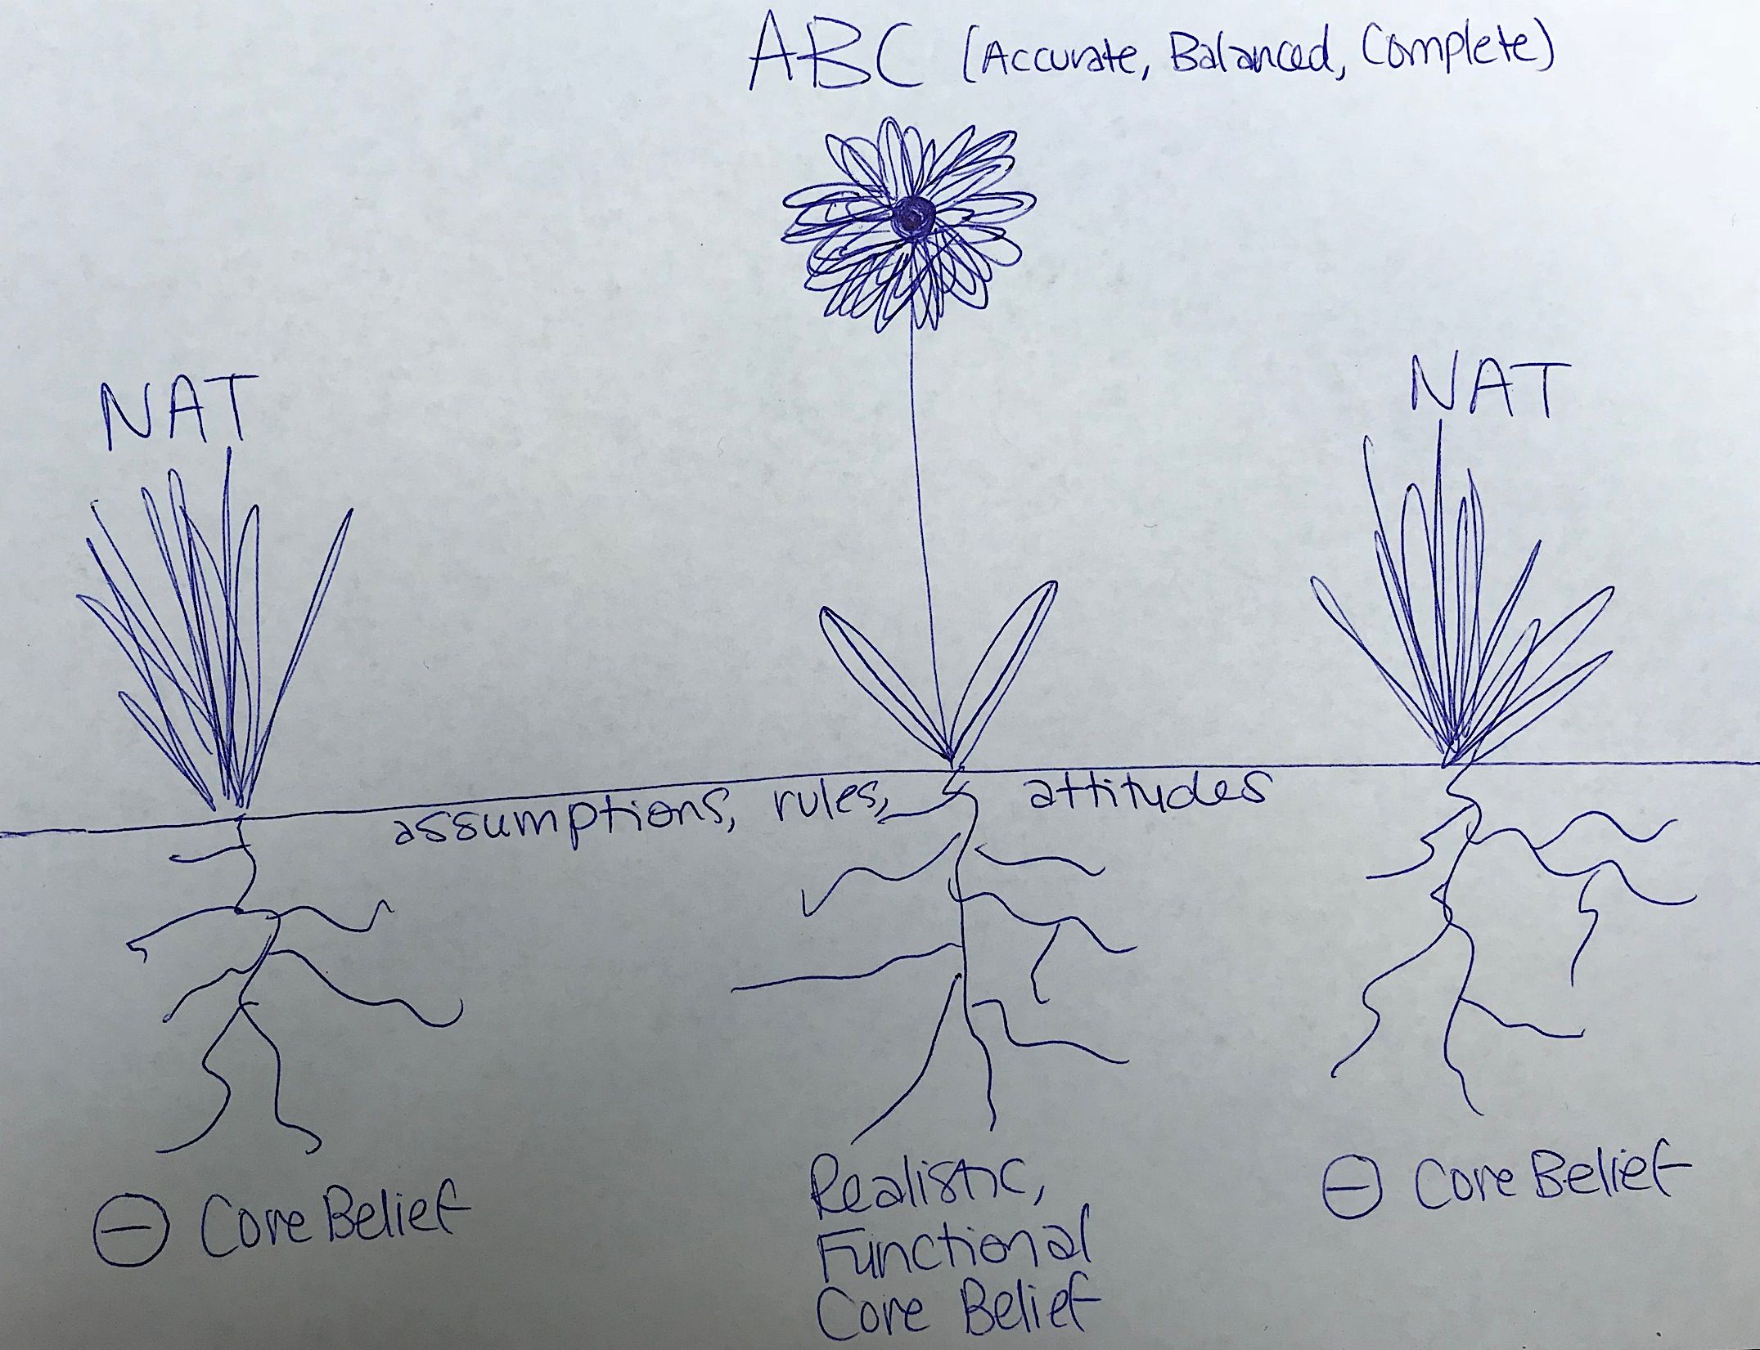
How do we explain core beliefs to clients?
Notes:
There are many ways to explain core beliefs to clients, and metaphors can be helpful.
Using the garden metaphor, you might first draw some weeds and say, “These weeds are Negative Automatic Thoughts. So far, we’ve been ripping these from the ground by using the NAT form. But, what’s the most effective way of getting rid of weeds? Pulling from the root! The roots of our daily thoughts are our core beliefs – absolute, all-or-nothing views ourselves, other people and the world. Negative core beliefs give rise to negative automatic thoughts. We’re going to work to identify your negative core beliefs so we can eradicate them. And, we’re also going to nurture realistic, functional core beliefs, which are the roots of flowers – that is, balanced thoughts!”

Slide 7
How do we explain core beliefs to clients?
Notes:
Another helpful metaphor is the blocks metaphor.
Ask the client to imagine a children’s toy that has blocks of different shapes and holes of different shapes to place the blocks in.
You say, “Imagine that triangles are positive experiences, circles are neutral experiences, and squares are negative experiences. When a negative core belief is active, and a realistic, functional core belief is not, it’s as if our toy has only a square hole. We try to squeeze in our positive triangles or our neutral circles, but they simply don’t fit. The only blocks that fit are the negative squares. So what do we do? We either toss out the triangles and circles, or we jam them in by making them fit a negative mold. By creating new core beliefs, we add a circle hole and a triangle hole. That way, we can accept and integrate positive and neutral experiences.”

Slide 8
How do we explain core beliefs to clients?
https://www.psychologytools.com/core-belief-magnets.html
Notes:
One last metaphor is a magnet.
Core beliefs attract confirming evidence and repel disconfirming evidence.

Slide 9
How do we identify clients’ core beliefs?
A client might come right out and name a negative core belief
Otherwise, negative core beliefs are underlying NATs
Choose situation that evokes a negative mood and identify the NAT
Then, DOWNWARD ARROW:
If this [NAT] is true, what does it say/mean about me?
And if that is true, what does it say/mean about me?
And if that is true, what does it say/mean about me?
Notes:
Moving on, how do we identify clients’ core beliefs?
A client might come right out and name their negative core belief
Otherwise, negative core beliefs are underlying NATs
In this case, choose situation that evokes a strong, negative mood identify the NAT
Then use the downward arrow technique.
If this [NAT] is true, what does it say/mean about me?
And if that is true, what does it say/mean about me?
And if that is true, what does it say/mean about me?

Slide 10
Examples of Core Beliefs
HELPLESS | UNLOVEABLE | WORTHLESS
I am incompetent I am needy I am a failure I am out of control I am weak I am vulnerable I can’t do anything right I am ineffective I am a victim I am a loser I am trapped | I am unlikeable I am undesirable I am different I am not good enough I am unwanted I am bound to be alone I am defective I am unattractive I am bad I am uncared for | I am unacceptable I am a waste I am immoral I am dangerous I am toxic I am evil I don’t deserve to live I am bad
Notes:
Core beliefs tend to fall into 3 categories: helpless, unlovable, and worthless.
Here are some examples of core beliefs that fall into these categories.

Slide 11
How do we help clients develop new core beliefs?
It is not so effective to test core beliefs with Thought Records / NAT forms
Instead, we ask clients to:
1) identify new core beliefs they would like to hold
2) look for evidence to support or strengthen their new core beliefs
Message: We can activate new beliefs and de-activate old beliefs!
A new core belief is not meant to be positive opposite of the old core belief
It is meant to be realistic and functional
Notes:
So, how do we help clients develop new core beliefs?
It is not so effective to test core beliefs with Thought Records / NAT forms.
Instead, we ask clients to identify new core beliefs they would like to hold and look for evidence to support or strengthen their new core beliefs.
The message we want to emphasize is that we can activate new core beliefs and de-activate old core beliefs.
You can use the metaphor of turning the volume up on a new core belief and turning the volume down on an old core belief.
It’s important to note that a new core belief isn’t simply the positive opposite of the old core belief (e.g. not from “I’m flawed” to “I’m perfect”)
Rather, the new core belief is meant to be realistic and functional.

Slide 12
Client Examples
CLIENT | OLD CORE BELIEF | NEW CORE BELIEF
ID 78 | I’m not good enough | I’m good enough just the way I am
ID 86 | My depression defines me | I am a unique individual dealing with depression
ID 109 | I’m selfish | I care for myself and for others
ID 112 | I’m weak emotionally | I embrace my emotions
ID 113 | I’m unlikeable | I have likeable qualities
Notes:
Here are some examples from clients of ours.

Slide 13
Developing New Core Beliefs: Positive Data Log
Identify a new core belief and have the client record evidence to support it
“Who is someone you admire for embodying this quality? What’s something you did that, if s/he had done it, you’d say was evidence that s/he embodies this quality?
“Who is someone who knows you well, who you trust? What would s/he say that you’ve done that supports this new core belief?”
If the client discounts positive evidence, compare their action to a hypothetical, e.g. “Would a truly incompetent person have been able to…?”
Notes:
One way of helping clients develop new core beliefs is using a positive data log.
For this activity, you and the client come up a new core belief. Then, you ask the client to find evidence to support it.
This works best as a daily practice – having the client log a number of pieces of evidence per day.
The client might find it hard to come up with evidence to support the new core belief, so here are some guiding questions:
1) “Who is someone you admire for embodying this quality? What’s something you did that, if s/he had done it, you’d say was evidence that s/he embodies this quality?
2) “Who is someone who knows you well, who you trust? If she had a bird’s eye view on your day, what would s/he say that you’ve done that supports this new core belief?”
3) “What do you think I’d say is evidence that supports this new core belief?”
If the client discounts positive evidence, compare their action to a hypothetical, e.g. “Would a truly incompetent person have been able to…?”

Slide 14
Developing New Core Beliefs: Scaling
“From 0 to 100, how incompetent are you?”
“Can you think of someone – from real life or from fiction – who is truly incompetent or who acts truly incompetently? From 0 to 100, how incompetent is that person?”
“Now, let’s look at the scale again…Compared to that person, how incompetent are you?”
ME
Least Incompetent
Most Incompetent
INCOMPETENT PERSON
ME
INCOMPETENT PERSON
Notes:
Another way of helping clients develop new core beliefs is scaling.
We’ll take as an example a client with the old core belief “I am incompetent.”
You start by drawing a scale, and you ask the client to rate their incompetence from 0 to 100.
Then you ask the client to imagine someone who is truly incompetent, and you ask the client to rate that person on the same scale.
Finally you ask the client reconsider their position on the scale relative to the truly incompetent person. Does their position change?
When doing this activity, it can help to define terms. Brainstorm with your client – what does it mean to be incompetent? Does the client fit that definition? Does anyone else fit it better?

Slide 15
Developing New Core Beliefs: Behavioral Experiments
Do experiments to test out behaviors that are consistent with the new core belief and inconsistent with the old core belief
These might be behaviors you’d do if you had confidence in your new core belief
Acting “as if”
See page 174 in Mind Over Mood
Example:
Old Core Belief: I am less important than other people.
New Core Belief: My needs are important, too.
Behavior: I speak up for what I need.
Experiment: Try speaking up with strangers first, then later try with friends and family.
Notes:
Another way of helping clients develop new core beliefs is by conducting behavioral experiments.
You can have the client test out behaviors that are consistent with the new core belief and inconsistent with the old core belief
Page 174 in Mind Over Mood has a worksheet for this.
Example:
Old Core Belief: I am less important than other people.
New Core Belief: My needs are important, too.
Behavior: I speak up for what I need.
Experiment: Try speaking up with strangers first, then later try with friends and family.

Slide 16
Developing New Core Beliefs: Positive Downward Arrow
Throughout therapy, use tools to help the client to identify positive evidence about self, others, and the world
Gratitude Practice
Credit List
Compliments Log
Use downward arrow technique for these examples
e.g. “What does it say about you that you started this project?”
Notes:
Another way of helping clients develop new core beliefs is by using the “downward arrow” technique with a positive spin.
Throughout therapy, you can use different tools to help the client capture positive evidence about self, others, and the world.
Some examples include gratitude practice, a credit list, and a compliments log.
With gratitude practice, you might specifically prompt the client to include three sections: gratitude for myself, gratitude for other people, and gratitude for the world.
A credit list is a way for clients to acknowledge their accomplishments, large and small, on a daily basis.
A compliments log is a way for clients to hold onto any positive feedback they get – feedback which people experiencing depression often forget, ignore, or disqualify.
When the client shares their positive evidence, you can use the downward arrow to ask, “What does this say about you?” For example, “What does it say about you that you started this project?” or “What does it say about you that you sent that birthday card?”

Slide 17
Developing New Core Beliefs: Historical Perspective
Ask, “When is the very first time you remember having this negative core belief?”
Have the client revisit this memory in detail (e.g. “What were you doing, thinking, feeling?”)
Give the client the opportunity to speak to their younger self (e.g. “What would you like your young self to know?”)
Remind the client that as children, we accept what we’re taught as truth, because we don’t have the critical thinking skills to question it
Ask the client, “In retrospect, was this belief true?”
Notes:
Another way of helping clients develop new core beliefs is by taking a historical perspective, helping the client to think critically about the origins of their negative core beliefs.
You might ask the client, “When is the very first time you remember having this negative core belief?”
If appropriate, you might have the client revisit this memory in detail. You can evoke the memory using the senses and the cognitive model: What were you doing? Thinking? Feeling?
Evoking emotion can be really effective here.
One option here is to have the client speak to their younger self. Or, you might do a role play, in which you play the younger self and the client plays the adult self.
The point is for the client to see that, as a child, it simply wasn’t true that they weren’t good enough, or smart enough, or whatever. Their negative core belief was formed on a false, faulty foundation.
Ultimately, you’re asking, “In retrospect, was this belief true?”
We remind the client that, as children, we accept what we’re taught as truth, because we don’t have the critical thinking skills to question it.
Ideally, the client looks back on their young self with compassion – compassion they can apply then to their current self.
If the core belief wasn’t true then… how could it be true now?
Client Example: ID 78 did not get enough attention from her parents when she was a kid. They sat her in front of the TV instead of interacting with her. She thought she had to be perfect in order to be noticed, and no matter how hard she tried to be perfect she still didn’t get noticed. So she concluded she could never be good enough for her parents’ attention. She developed the attitude “I have to be perfect” and the negative core belief “I’m not good enough.” In session, we evoked the memory of the client sitting in front of the TV as a child. Through this activity, she was able to gain perspective. By considering from an adult lens what was really going on then, she realized that it wasn’t about being perfect– her parents simply didn’t give her the attention she deserved as an innocent kid who couldn’t care for herself. It wasn’t fair, and it wasn’t true that she wasn’t good enough. We wrote down these conclusions on cue cards, and she read them to herself every day.

Slide 18
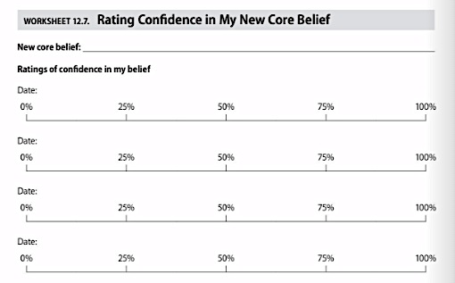
Developing New Core Beliefs: Rating Confidence
As you work on developing core beliefs, have the client continuously rate their percentage confidence in the new core belief
Notes:
As you work on developing core beliefs, it helps to have the client continuously rate their percentage confidence in the new core belief.
As you use the tools we’ve discussed, you will likely see their confidence grow!

Slide 19
Questions and Client Consultation

